Slide 1
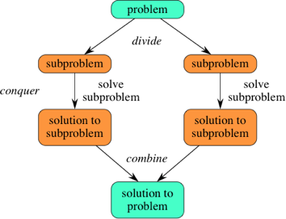
Divide & Conquer Algorithms
Page.No1

Slide 2
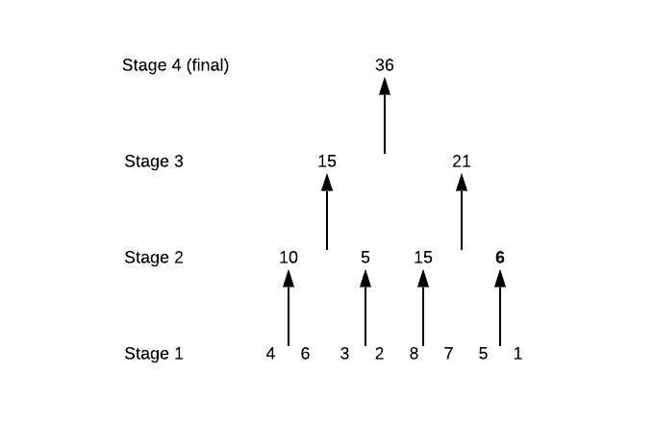
Example

Slide 3
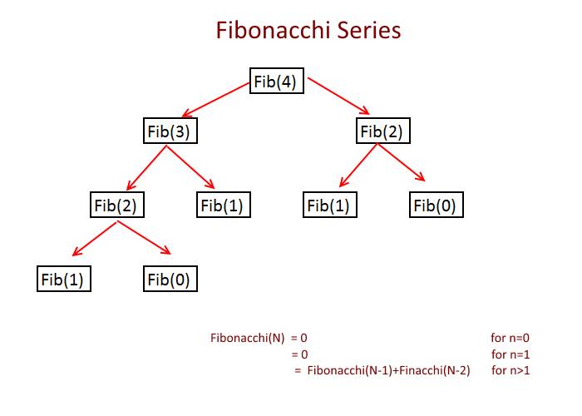
Example

Slide 4
Structure of Divide and Conquer
Divide
Break a problem into sub problem(s)
Conquer
Solve all sub problem(s) (Recursively)
Combine
combine results of the sub problem(s) to give solution to original problem

Slide 5
Concept of recursion
Consider the function.
F()
temp←2*F()
RETURN temp
When F() is called,
F()=temp=2*F()
It will not solve the equation. It continues.
=2*(2*F())
=2*(2*(2*F()))
...
temp
temp
temp
Stack

Slide 6
Concept of recursion
The concept of terminating condition(s) is/are needed.
It is determined by the parameter(s).

Slide 7
Concept of recursion
Consider the function
F(n)
IF (n=0)
RETURN 1
ELSE
RETURN n*F(n-1)
When F(2) is called,
F(2)=2*F(1)
=2*(1*F(0))
=2*(1*(1))
=2*(1*1)
=2*1
=2
n
n
n
Stack

Slide 8
Structure of recursion
Similar to mathematic induction, recursion requires the following two components
Recurrence relation(s)
Base case(s)
Example
F(n)
 | IF (n=0) RETURN 1 | //Base Case
 | ELSE RETURN n* F(n-1) | //Recurrence Relation

Slide 9
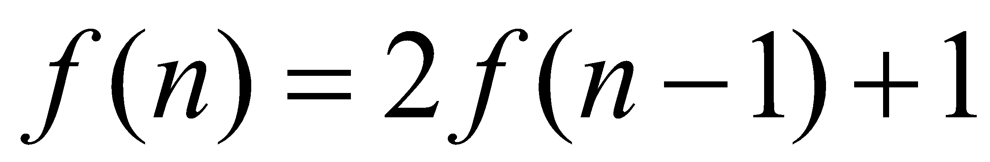
Complexity of recursion
Recurrence Iteration and Recursion Tree
n>1
= 0 n =1

Slide 10
Complexity of recursion
Recurrence Iteration and Recursion Tree
_
f(4)
=1+2f(3)
=1+2+4f(2)
=1+2+4+8f(1)
=1+2+4+8+.
= 15

Slide 11
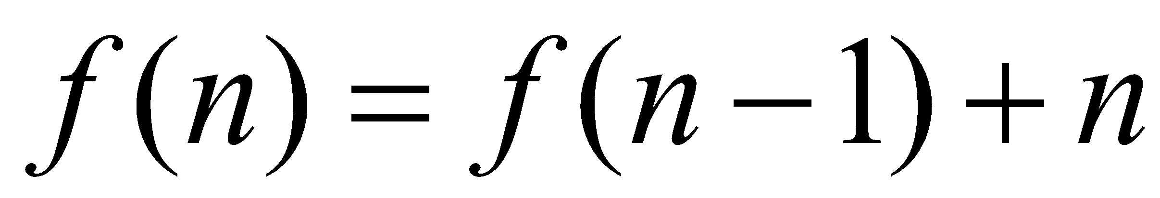
Complexity of recursion
f(8)
=

Slide 12
Complexity of recursion
f(8)
=8+f(7)
=8+7+f(6)
=8+7+6+f(5)
=8+7+6+5+f(4)
=8+7+6+5+4+f(3)
=8+7+6+5+4+3+f(2)
=8+7+6+5+4+3+2+f(1)
= 8+7+6+5+4+3+2+1+f(0)

Slide 13
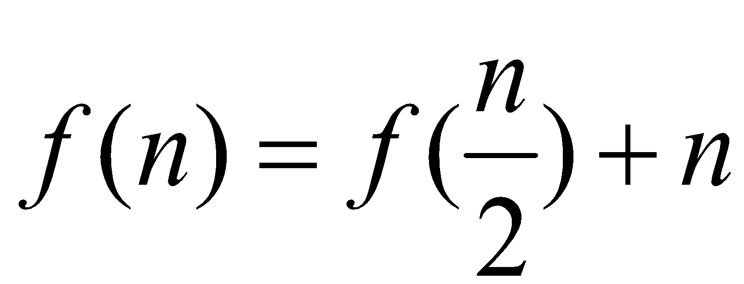
Complexity of recursion
_
f(256)
=

Slide 14
Complexity of recursion
_
f(256)
=256+f(128)
=256+128+f(64)
=256+128+64+f(32)
=256+128+64+32+f(16)
=256+128+64+32+16+f(8)
=256+128+64+32+16+8+f(4)
=256+128+64+32+16+8+4+f(2)
=256+128+64+32+16+8+4+2+f(1)

Slide 15
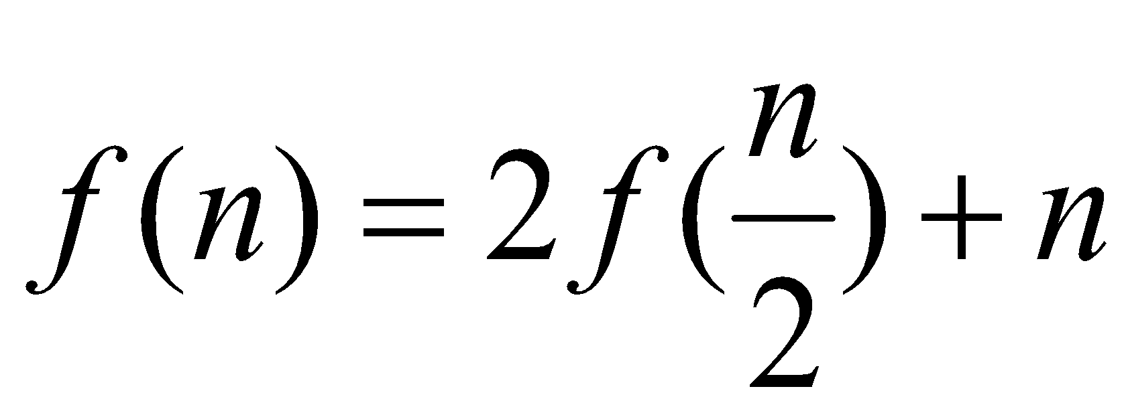
Complexity of recursion
_
f(32)
=

Slide 16
Complexity of recursion
_
f(32)
=32+2(f(16))
=32+2(16)+4(f(8))
=32+2(16)+4(8)+8(f(4))
=32+2(16)+4(8)+8(4)+16(f(2))
=32+2(16)+4(8)+8(4)+16(2)+32(f(1))

Slide 17
Solve following recurrence for n=8, , f(1) = 1
What is your conclusion ?

Slide 18
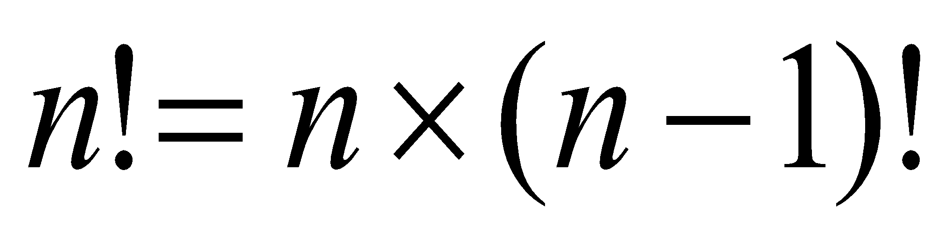
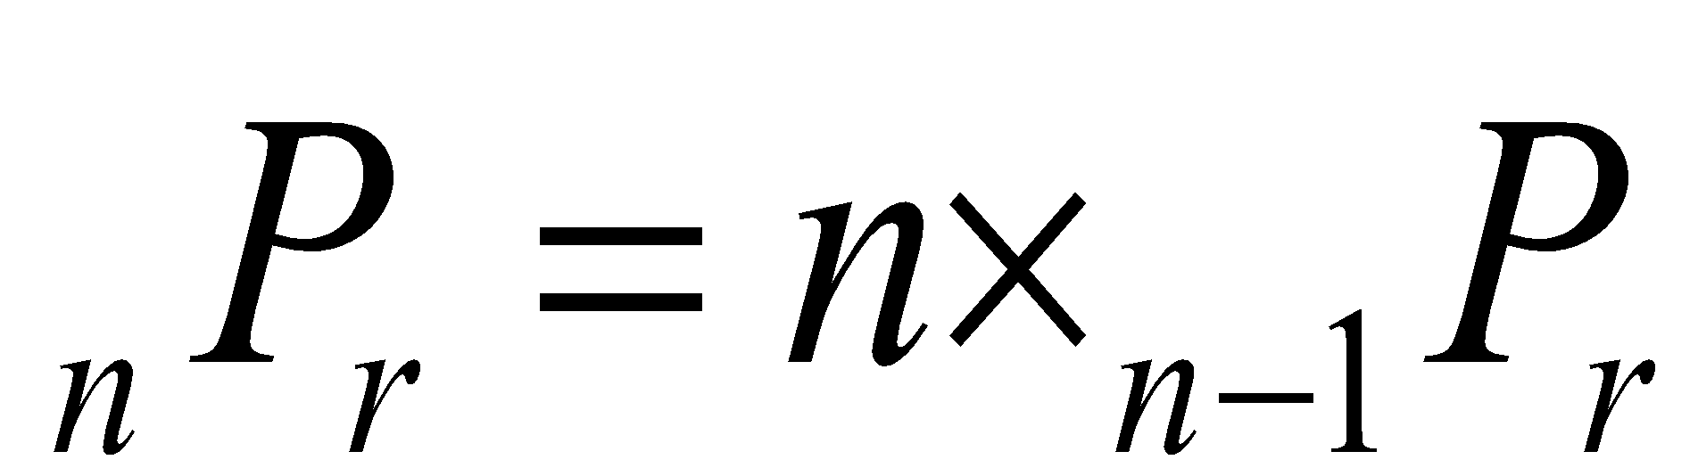
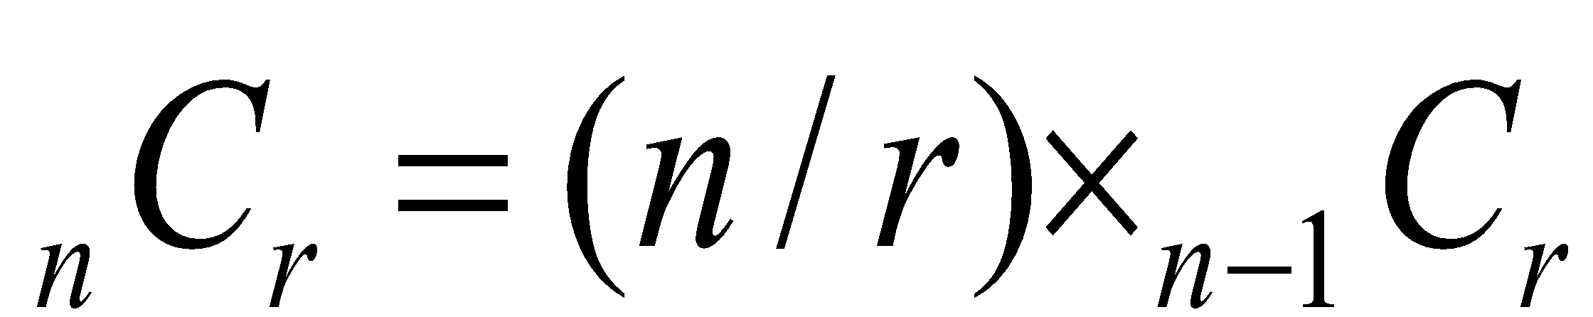
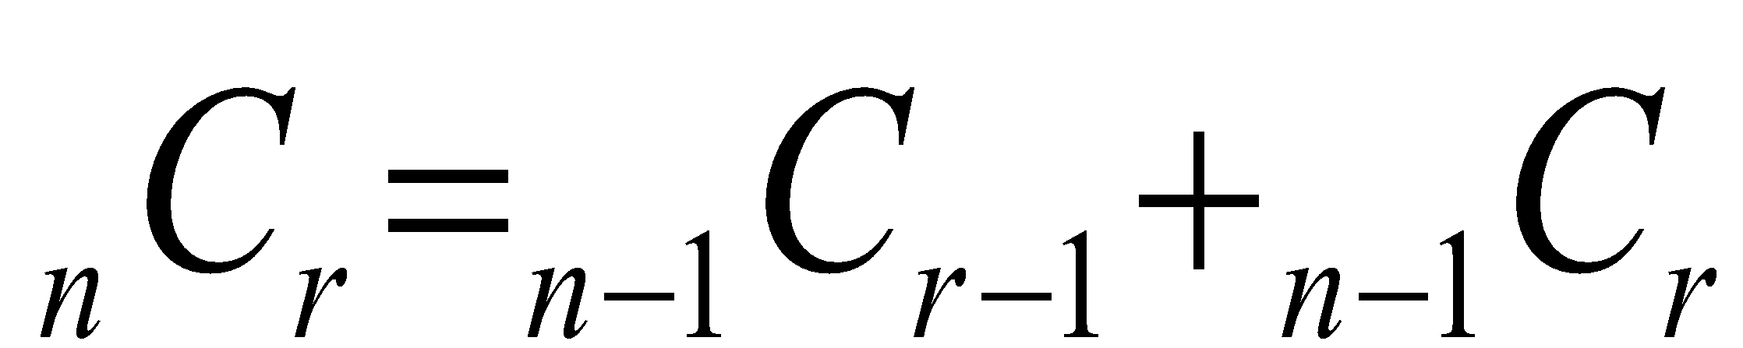
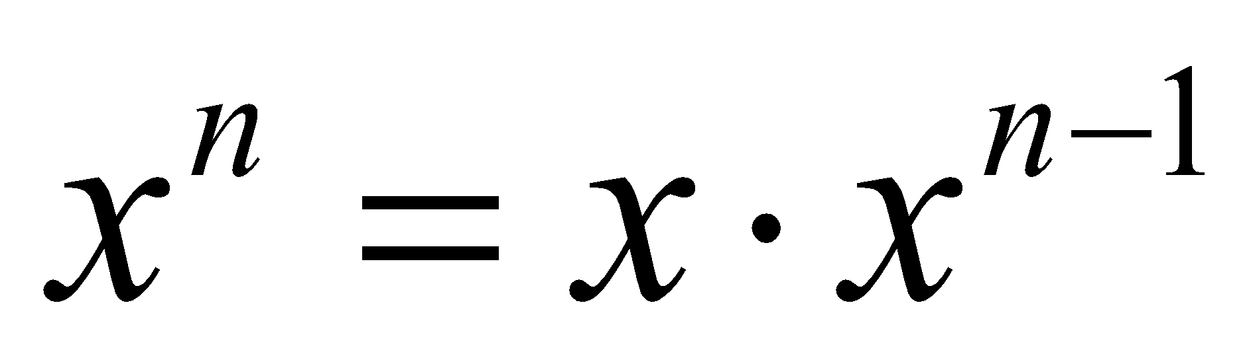
Recurrence in mathematical functions
Factorial
_
Permutation
_
Combination
_
Pascal relationship
_
Integer power
_

Slide 19
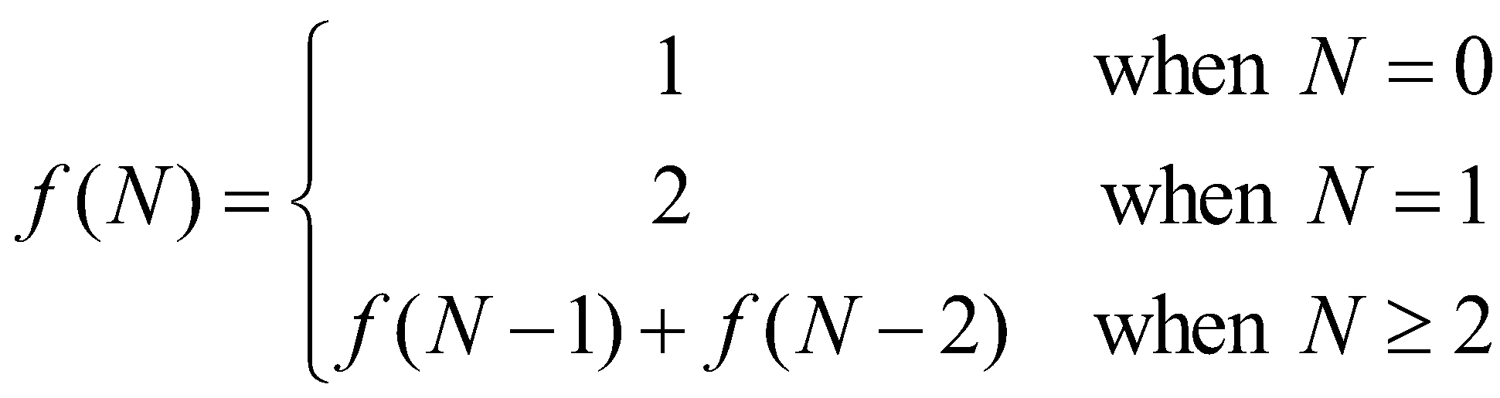
Fibonacci Series
Let f(N) be the number of solutions to S(N).

Slide 20
General Divide-and-Conquer Recurrence
T(n) = aT(n/b) + f (n) where f(n) ∈ Θ(n^{d}), d ≥ 0
Master Theorem: If a < b^{d}, T(n) ∈ Θ(n^{d})
If a = b^{d}, T(n) ∈ Θ(n^{d} log n)
If a > b^{d}, T(n) ∈ Θ(n^{log b a} )
.
Examples: T(n) = 4T(n/2) + n ⇒ T(n) ∈ ?
T(n) = 4T(n/2) + n² ⇒ T(n) ∈ ?
T(n) = 4T(n/2) + n³ ⇒ T(n) ∈ ?
Θ (n^2)
Θ (n^2log n)
Θ (n^3)

Slide 21
Properties of recursion
NP solutions, including exponential, factorial and combinatorial, are usually easy to be implemented by recursion.
It requires more memory than iteration.
Every recursive function can be transformed into iterative function.
Every iterative function can be transformed into recursive function.

Slide 22
Structure of Divide and Conquer
Divide
Break a problem into sub problem(s)
Conquer
Solve all sub problem(s)
Combine
Solve the problem using the results of the sub problem(s)

Slide 23
Divide-and-Conquer Technique (cont.)
a problem of size n
(instance)
subproblem 1
of size n/2
subproblem 2
of size n/2
a solution to
subproblem 1
a solution to
subproblem 2
a solution to
the original problem
It general leads to a recursive algorithm!

Slide 24
Recurrences
Running times of algorithms with Recursive calls can be described using recurrences
A recurrence is an equation or inequality that describes a function in terms of its value on smaller inputs

Slide 25
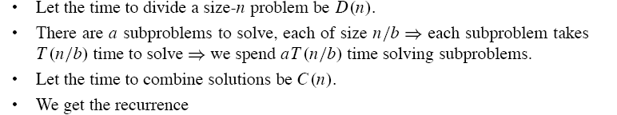
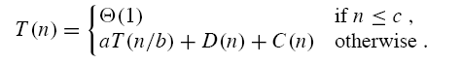
Analysis of Divide and Conquer

Slide 26
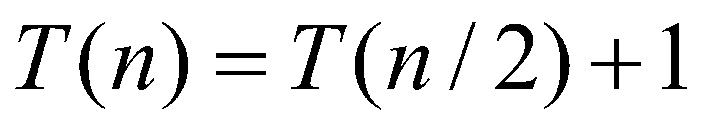
Master Method, Example 6
T(n) = aT(n/b) + f (n) where f(n) ∈ Θ(n^{d}), d ≥ 0
Master Theorem: If a < b^{d}, T(n) ∈ Θ(n^{d})
If a = b^{d}, T(n) ∈ Θ(n^{d} log n)
If a > b^{d}, T(n) ∈ Θ(n^{log b a} )
Example:
(binary search)
Solution: T(n) is O(log n).

Slide 27
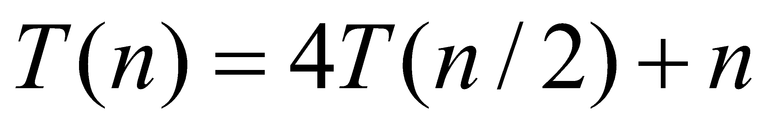
Master Method, Example 1
T(n) = aT(n/b) + f (n) where f(n) ∈ Θ(n^{d}), d ≥ 0
Master Theorem: If a < b^{d}, T(n) ∈ Θ(n^{d})
If a = b^{d}, T(n) ∈ Θ(n^{d} log n)
If a > b^{d}, T(n) ∈ Θ(n^{log b a} )

Slide 28
Divide-and-Conquer Examples
Sorting:
Binary Search
Merge Sort
Quick Sort

Slide 29
Sequential Search
T[] is a sequence in non decreasing order
Find an element in T[]
sequentialSearch(T[], x)
{
for (i=0; i<n; i++)
{
if (T[i] == x)
return i;
}
}
Cost: best, worst, average?

Slide 30
Binary Search
Divide :
check middle element
Conquer:
recursively search 1 subarray
Combine:
trivial

Slide 31
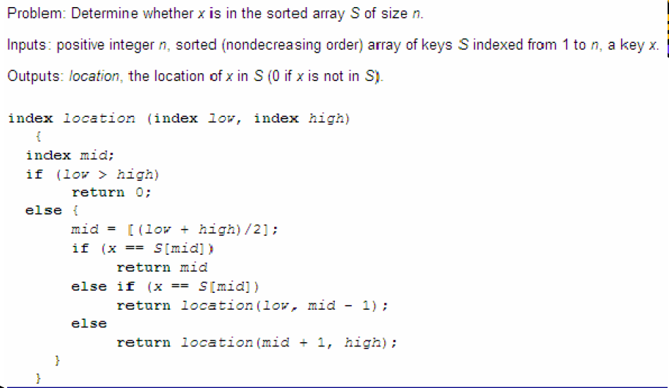
Recursive Algorithm

Slide 32
Binary Search Algorithm
The algorithm searches for an element x in an ascending array of elements a[1],…,a[n] .
Algorithm body:
index:=0, bot:=1, top:=n
while (top ≥ bot and index=0)
mid := ⎣ (bot+top) / 2⎦
if a[mid] = x then index := mid
if a[mid] > x
then top := mid-1
else bot := mid+1
end while
Output: index
(If index has the value 0 then x is not in the array; otherwise, index gives the index of the array where x is located.)

Slide 33
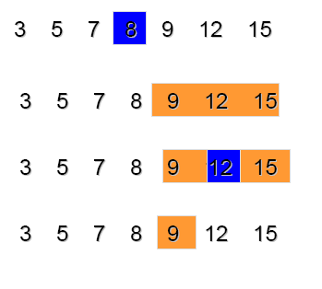
Binary Search Example

Slide 34
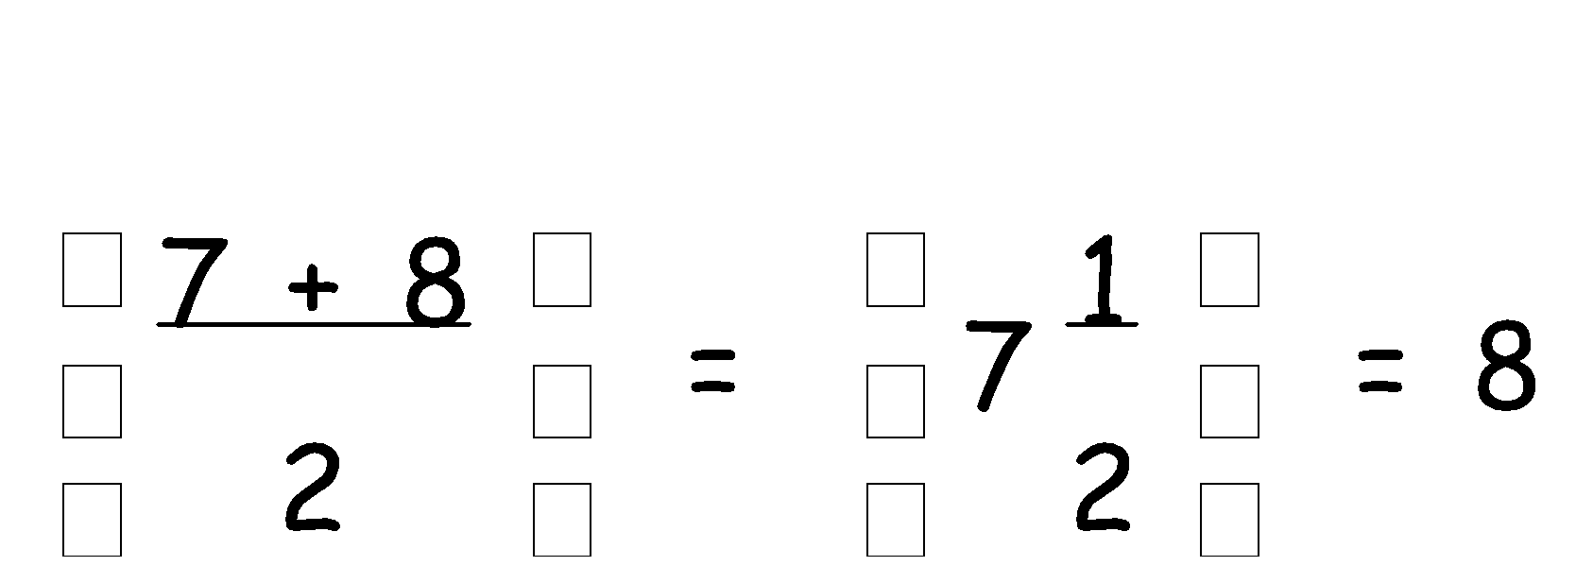
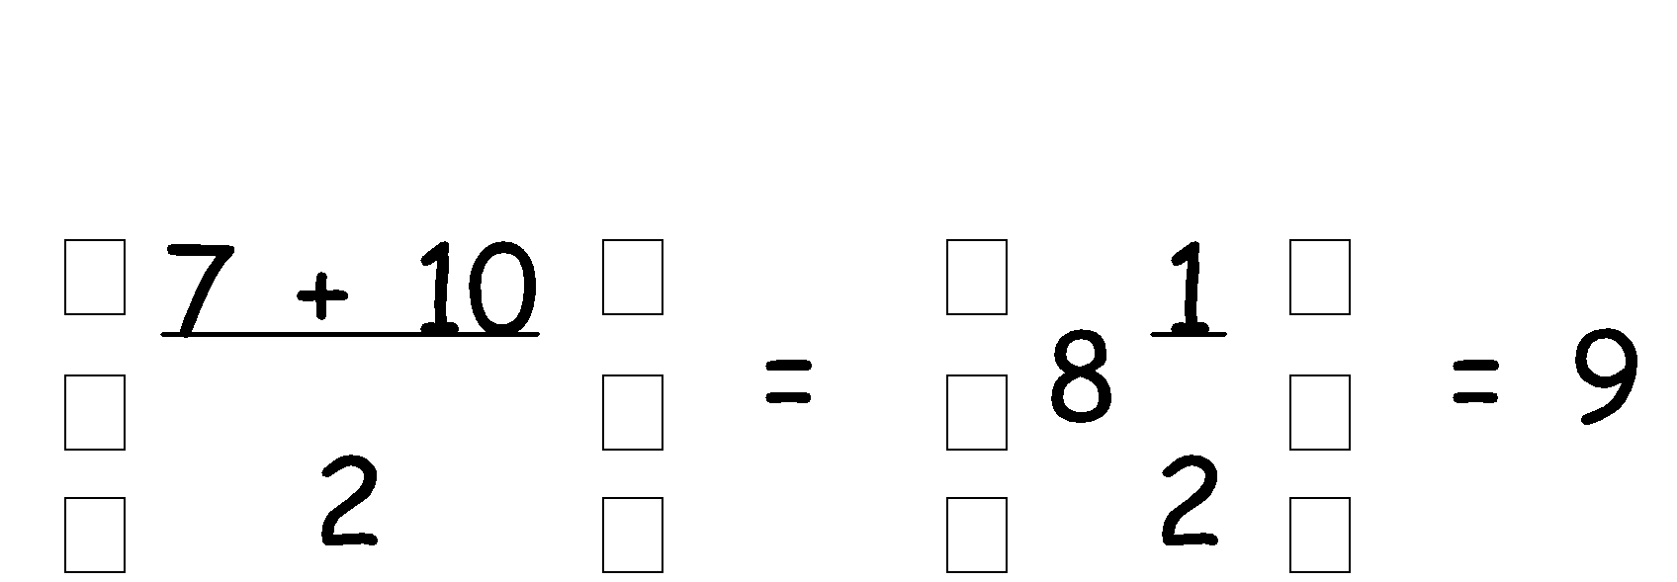
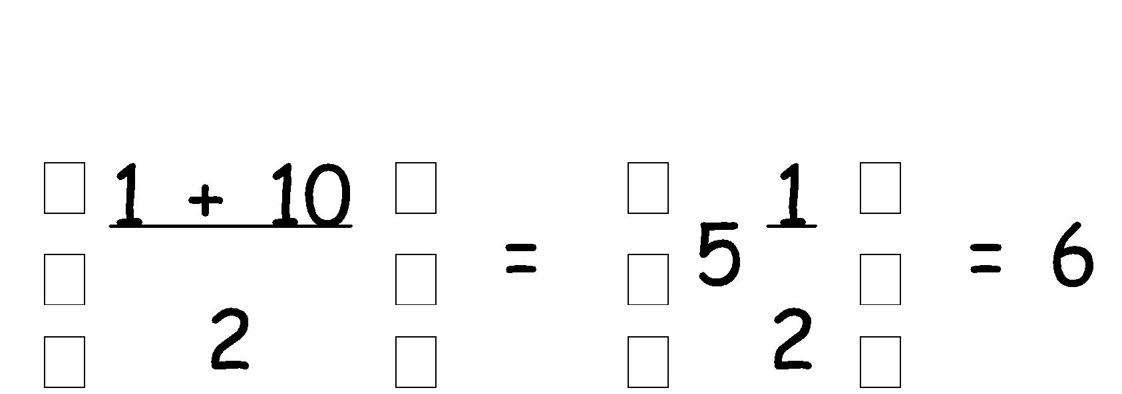
Find the name Robinson in the list below:
Middle name:
1 Bennett
6 Laing
2 Blackstock
3 Brown
Robinson is after Laing
So delete names 1-6
This leaves names 7 to 10
4 Ebenezer
Middle name:
5 Fowler
9 Saludo
6 Laing
Robinson is before Saludo
So delete names 9-10
7 Leung
This leaves names 7 to 8
8 Robinson
Middle name:
8 Robinson
9 Saludo
has been found!
10 Scadding

Slide 36
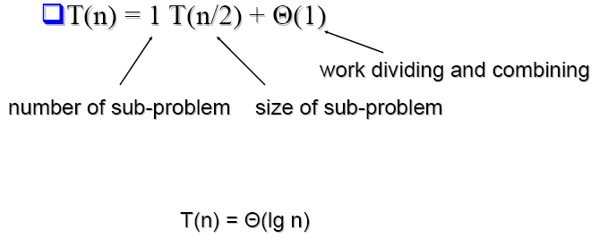
Analysis
Recurrence Equation

Slide 37
Ternary Search
Ternary search is a divide and conquer algorithm that can be used to find an element in an array.
We can divide the array into three parts by taking mid1 and mid2.
Initially, l and r will be equal to 0 and n-1 respectively, where n is the length of the array.
mid1 = l + (r-l)/3
mid2 = mid1+(r-l)/3

Slide 38
Ternary Search
Ternary search is a divide and conquer algorithm that can be used to find an element in an array.
We can divide the array into three parts by taking mid1 and mid2.
Initially, l and r will be equal to 0 and n-1 respectively, where n is the length of the array.
mid1 = l + (r-l)/3
mid2 = mid1+(r-l)/3

Slide 39
Steps to perform Ternary Search:
First, we compare the key with the element at mid1. If found equal, we return mid1.
If not, then we compare the key with the element at mid2. If found equal, we return mid2.
If not, then we check whether the key is less than the element at mid1. If yes, then recur to the first part.
If not, then we check whether the key is greater than the element at mid2. If yes, then recur to the third part.
If not, then we recur to the second (middle) part.

Slide 40
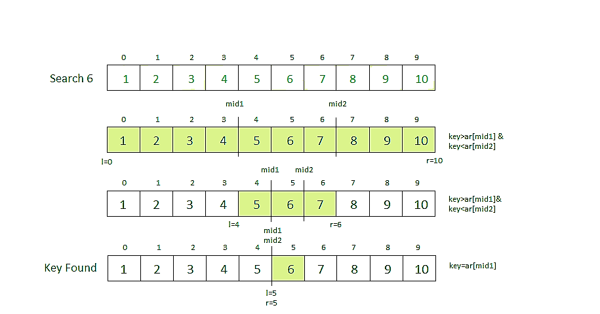
Example

Slide 41
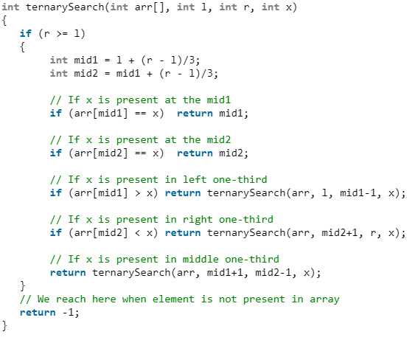
Ternary Search Algorithm

Slide 42
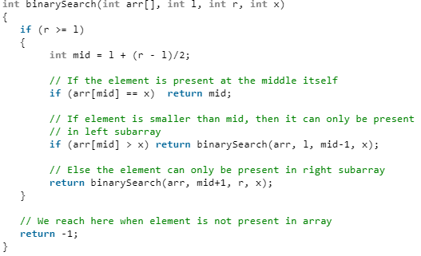
Comparison Binary Vs Ternary

Slide 43
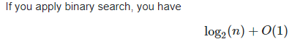
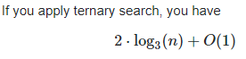
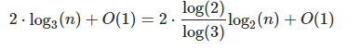
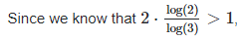
Analysis
we actually get more comparisons with ternary search.

Slide 44
Merge Sort Algorithm
Divide:
If S has at least two elements, remove all the elements from S and put them into two sequences, S₁ and S₂ , each containing about half of the elements of S.
Conquer:
Sort sequences S₁ and S₂ using Merge Sort.
Combine:
Put back the elements into S by merging the sorted sequences S₁ and S₂ into one sorted sequence

Slide 45
Merge Sort: Algorithm
Merge-Sort(A, p, r)
if p < r then
q¬(p+r)/2
Merge-Sort(A, p, q)
Merge-Sort(A, q+1, r)
Merge(A, p, q, r)
Merge(A, p, q, r)
Take the smallest of the two topmost elements of sequences A[p..q] and A[q+1..r] and put into the resulting sequence. Repeat this, until both sequences are empty. Copy the resulting sequence into A[p..r].

Slide 46
98
23
45
14
6
67
33
42

Slide 47
98
23
45
14
6
67
33
42
98
23
45
14
6
67
33
42

Slide 48
98
23
45
14
6
67
33
42
98
23
45
14
6
67
33
42
98
23
45
14

Slide 49
98
23
45
14
6
67
33
42
98
23
45
14
6
67
33
42
98
23
45
14
98
23

Slide 50
98
23
45
14
6
67
33
42
98
23
45
14
6
67
33
42
98
23
45
14
98
23
Merge

Slide 51
98
23
45
14
6
67
33
42
98
23
45
14
6
67
33
42
98
23
45
14
98
23
23
Merge

Slide 52
98
23
45
14
6
67
33
42
98
23
45
14
6
67
33
42
98
23
45
14
98
23
23
98
Merge

Slide 53
98
23
45
14
6
67
33
42
98
23
45
14
6
67
33
42
98
23
45
14
98
23
45
14
23
98

Slide 54
98
23
45
14
6
67
33
42
98
23
45
14
6
67
33
42
98
23
45
14
98
23
45
14
23
98
Merge

Slide 55
98
23
45
14
6
67
33
42
98
23
45
14
6
67
33
42
98
23
45
14
98
23
45
14
23
98
14
Merge

Slide 56
98
23
45
14
6
67
33
42
98
23
45
14
6
67
33
42
98
23
45
14
98
23
45
14
23
98
14
45
Merge

Slide 57
98
23
45
14
6
67
33
42
98
23
45
14
6
67
33
42
98
23
45
14
98
23
45
14
23
98
14
45
Merge

Slide 58
98
23
45
14
6
67
33
42
98
23
45
14
6
67
33
42
98
23
45
14
98
23
45
14
23
98
14
45
14
Merge

Slide 59
98
23
45
14
6
67
33
42
98
23
45
14
6
67
33
42
98
23
45
14
98
23
45
14
23
98
14
45
14
23
Merge

Slide 60
98
23
45
14
6
67
33
42
98
23
45
14
6
67
33
42
98
23
45
14
98
23
45
14
23
98
14
45
14
23
45
Merge

Slide 61
98
23
45
14
6
67
33
42
98
23
45
14
6
67
33
42
98
23
45
14
98
23
45
14
23
98
14
45
14
23
45
98
Merge

Slide 62
98
23
45
14
6
67
33
42
98
23
45
14
6
67
33
42
98
23
45
14
6
67
33
42
98
23
45
14
23
98
14
45
14
23
45
98

Slide 63
98
23
45
14
6
67
33
42
98
23
45
14
6
67
33
42
98
23
45
14
6
67
33
42
98
23
45
14
6
67
23
98
14
45
14
23
45
98

Slide 64
98
23
45
14
6
67
33
42
98
23
45
14
6
67
33
42
98
23
45
14
6
67
33
42
98
23
45
14
6
67
23
98
14
45
14
23
45
98
Merge

Slide 65
98
23
45
14
6
67
33
42
98
23
45
14
6
67
33
42
98
23
45
14
6
67
33
42
98
23
45
14
6
67
23
98
14
45
6
14
23
45
98
Merge

Slide 66
98
23
45
14
6
67
33
42
98
23
45
14
6
67
33
42
98
23
45
14
6
67
33
42
98
23
45
14
6
67
23
98
14
45
6
67
14
23
45
98
Merge

Slide 67
98
23
45
14
6
67
33
42
98
23
45
14
6
67
33
42
98
23
45
14
6
67
33
42
98
23
45
14
6
67
33
42
23
98
14
45
6
67
14
23
45
98

Slide 68
98
23
45
14
6
67
33
42
98
23
45
14
6
67
33
42
98
23
45
14
6
67
33
42
98
23
45
14
6
67
33
42
23
98
14
45
6
67
14
23
45
98
Merge

Slide 69
98
23
45
14
6
67
33
42
98
23
45
14
6
67
33
42
98
23
45
14
6
67
33
42
98
23
45
14
6
67
33
42
23
98
14
45
6
67
33
14
23
45
98
Merge

Slide 70
98
23
45
14
6
67
33
42
98
23
45
14
6
67
33
42
98
23
45
14
6
67
33
42
98
23
45
14
6
67
33
42
23
98
14
45
6
67
33
42
14
23
45
98
Merge

Slide 71
98
23
45
14
6
67
33
42
98
23
45
14
6
67
33
42
98
23
45
14
6
67
33
42
98
23
45
14
6
67
33
42
23
98
14
45
6
67
33
42
14
23
45
98
Merge

Slide 72
98
23
45
14
6
67
33
42
98
23
45
14
6
67
33
42
98
23
45
14
6
67
33
42
98
23
45
14
6
67
33
42
23
98
14
45
6
67
33
42
14
23
45
98
6
Merge

Slide 73
98
23
45
14
6
67
33
42
98
23
45
14
6
67
33
42
98
23
45
14
6
67
33
42
98
23
45
14
6
67
33
42
23
98
14
45
6
67
33
42
14
23
45
98
6
33
Merge

Slide 74
98
23
45
14
6
67
33
42
98
23
45
14
6
67
33
42
98
23
45
14
6
67
33
42
98
23
45
14
6
67
33
42
23
98
14
45
6
67
33
42
14
23
45
98
6
33
42
Merge

Slide 75
98
23
45
14
6
67
33
42
98
23
45
14
6
67
33
42
98
23
45
14
6
67
33
42
98
23
45
14
6
67
33
42
23
98
14
45
6
67
33
42
14
23
45
98
6
33
42
67
Merge

Slide 76
98
23
45
14
6
67
33
42
98
23
45
14
6
67
33
42
98
23
45
14
6
67
33
42
98
23
45
14
6
67
33
42
23
98
14
45
6
67
33
42
14
23
45
98
6
33
42
67
Merge

Slide 77
98
23
45
14
6
67
33
42
98
23
45
14
6
67
33
42
98
23
45
14
6
67
33
42
98
23
45
14
6
67
33
42
23
98
14
45
6
67
33
42
14
23
45
98
6
33
42
67
6
Merge

Slide 78
98
23
45
14
6
67
33
42
98
23
45
14
6
67
33
42
98
23
45
14
6
67
33
42
98
23
45
14
6
67
33
42
23
98
14
45
6
67
33
42
14
23
45
98
6
33
42
67
6
14
Merge

Slide 79
98
23
45
14
6
67
33
42
98
23
45
14
6
67
33
42
98
23
45
14
6
67
33
42
98
23
45
14
6
67
33
42
23
98
14
45
6
67
33
42
14
23
45
98
6
33
42
67
6
14
23
Merge

Slide 80
98
23
45
14
6
67
33
42
98
23
45
14
6
67
33
42
98
23
45
14
6
67
33
42
98
23
45
14
6
67
33
42
23
98
14
45
6
67
33
42
14
23
45
98
6
33
42
67
6
14
23
33
Merge

Slide 81
98
23
45
14
6
67
33
42
98
23
45
14
6
67
33
42
98
23
45
14
6
67
33
42
98
23
45
14
6
67
33
42
23
98
14
45
6
67
33
42
14
23
45
98
6
33
42
67
6
14
23
33
42
Merge

Slide 82
98
23
45
14
6
67
33
42
98
23
45
14
6
67
33
42
98
23
45
14
6
67
33
42
98
23
45
14
6
67
33
42
23
98
14
45
6
67
33
42
14
23
45
98
6
33
42
67
6
14
23
33
42
45
Merge

Slide 83
98
23
45
14
6
67
33
42
98
23
45
14
6
67
33
42
98
23
45
14
6
67
33
42
98
23
45
14
6
67
33
42
23
98
14
45
6
67
33
42
14
23
45
98
6
33
42
67
6
14
23
33
42
45
67
Merge

Slide 84
98
23
45
14
6
67
33
42
98
23
45
14
6
67
33
42
98
23
45
14
6
67
33
42
98
23
45
14
6
67
33
42
23
98
14
45
6
67
33
42
14
23
45
98
6
33
42
67
6
14
23
33
42
45
67
98
Merge

Slide 85
98
23
45
14
6
67
33
42
98
23
45
14
6
67
33
42
98
23
45
14
6
67
33
42
98
23
45
14
6
67
33
42
23
98
14
45
6
67
33
42
14
23
45
98
6
33
42
67
6
14
23
33
42
45
67
98

Slide 86
98
23
45
14
6
67
33
42
6
14
23
33
42
45
67
98

Slide 87
Merge Sort: Algorithm
Merge-Sort(A, p, r)
if p < r then
q¬(p+r)/2
Merge-Sort(A, p, q)
Merge-Sort(A, q+1, r)
Merge(A, p, q, r)
Merge(A, p, q, r)
Take the smallest of the two topmost elements of sequences A[p..q] and A[q+1..r] and put into the resulting sequence. Repeat this, until both sequences are empty. Copy the resulting sequence into A[p..r].

Slide 88
Merge(A,p,q,r)
Step 1: i¬p, j ¬q+1, L ¬ 0
Step 2: Repeat while i≤q && j≤r
if A[i] ≤ A[j] then L ¬ L + 1
Temp[L] ¬ A[i], i ¬ i + 1
else
L ¬ L + 1
Temp[L] ¬ A[j], j ¬ j + 1
Step 3: if i>q then
repeat while j ≤ r
L ¬ L + 1
Temp[L] ¬ A[j], j ¬ j + 1
else
repeat while i ≤ q
L ¬ L + 1
Temp[L] ¬ A[i], i ¬ i + 1
Step 4: Repeat for i=1,2,…L
A[p-1+i] ¬ Temp[L]
Step 5: Return

Slide 89
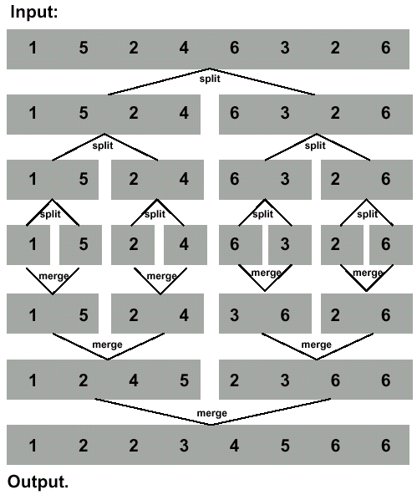
Merge Sort Revisited
To sort n numbers
if n=1 done!
recursively sort 2 lists of numbers n/2 and n/2 elements
merge 2 sorted lists in Q(n) time
Strategy
break problem into similar (smaller) subproblems
recursively solve subproblems
combine solutions to answer

Slide 90
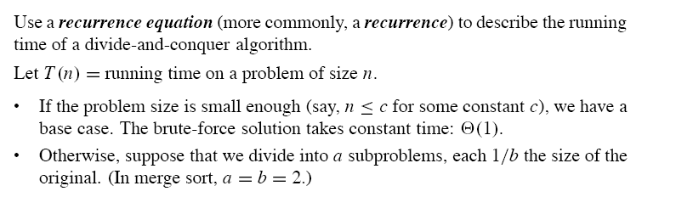
Analysis of Divide and Conquer

Slide 91
Analysis of Divide and Conquer

Slide 92
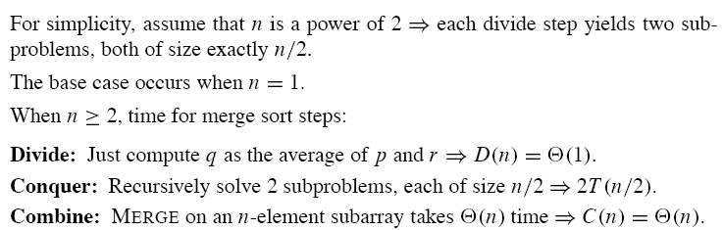
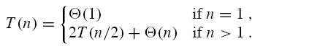
Analysis of Merge Sort

Slide 93
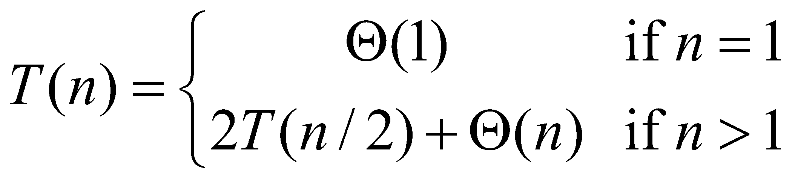
Recurrences
Running times of algorithms with Recursive calls can be described using recurrences
A recurrence is an equation or inequality that describes a function in terms of its value on smaller inputs
Example: Merge Sort

Slide 94
General Divide-and-Conquer Recurrence
T(n) = aT(n/b) + f (n) where f(n) ∈ Θ(n^{d}), d ≥ 0
Master Theorem: If a < b^{d}, T(n) ∈ Θ(n^{d})
If a = b^{d}, T(n) ∈ Θ(n^{d} log n)
If a > b^{d}, T(n) ∈ Θ(n^{log b a} )
Note: The same results hold with O instead of Θ.
Examples: T(n) = 4T(n/2) + n ⇒ T(n) ∈ ?
T(n) = 4T(n/2) + n² ⇒ T(n) ∈ ?
T(n) = 4T(n/2) + n³ ⇒ T(n) ∈ ?
Θ (n^2)
Θ (n^2log n)
Θ (n^3)

Slide 95
Quick sort

Slide 96
Pick Pivot Element
There are a number of ways to pick the pivot element. In this example, we will use the first element in the array:
40
20
10
80
60
50
7
30
100

Slide 97
Partitioning Array
Given a pivot, partition the elements of the array such that the resulting array consists of:
One sub-array that contains elements >= pivot
Another sub-array that contains elements < pivot
The sub-arrays are stored in the original data array.
Partitioning loops through, swapping elements below/above pivot.

Slide 98
40
20
10
80
60
50
7
30
100
pivot_index = 0
[0] [1] [2] [3] [4] [5] [6] [7] [8]
left_index
right_index

Slide 99
While data[left_index] <= data[pivot]
left_index++
pivot_index = 0
40
20
10
80
60
50
7
30
100
[0] [1] [2] [3] [4] [5] [6] [7] [8]
left_index
right_index

Slide 100
While data[left_index] <= data[pivot]
left_index++
pivot_index = 0
40
20
10
80
60
50
7
30
100
[0] [1] [2] [3] [4] [5] [6] [7] [8]
left_index
right_index

Slide 101
While data[left_index] <= data[pivot]
left_index++
pivot_index = 0
40
20
10
80
60
50
7
30
100
[0] [1] [2] [3] [4] [5] [6] [7] [8]
left_index
right_index

Slide 102
While data[left_index] <= data[pivot]
left_index++
While data[right_index] > data[pivot]
right_index--
pivot_index = 0
40
20
10
80
60
50
7
30
100
[0] [1] [2] [3] [4] [5] [6] [7] [8]
left_index
right_index

Slide 103
While data[left_index] <= data[pivot]
left_index++
While data[right_index] > data[pivot]
right_index--
pivot_index = 0
40
20
10
80
60
50
7
30
100
[0] [1] [2] [3] [4] [5] [6] [7] [8]
left_index
right_index

Slide 104
While data[left_index] <= data[pivot]
left_index++
While data[right_index] > data[pivot]
right_index--
If left_index < right_index
swap data[left_index] and data[right_index]
pivot_index = 0
40
20
10
80
60
50
7
30
100
[0] [1] [2] [3] [4] [5] [6] [7] [8]
left_index
right_index

Slide 105
While data[left_index] <= data[pivot]
left_index++
While data[right_index] > data[pivot]
right_index--
If left_index < right_index
swap data[left_index] and data[right_index]
pivot_index = 0
40
20
10
30
60
50
7
80
100
[0] [1] [2] [3] [4] [5] [6] [7] [8]
left_index
right_index

Slide 106
While data[left_index] <= data[pivot]
left_index++
While data[right_index] > data[pivot]
right_index--
If left_index < right_index
swap data[left_index] and data[right_index]
While right_index > left_index, go to 1.
pivot_index = 0
40
20
10
30
60
50
7
80
100
[0] [1] [2] [3] [4] [5] [6] [7] [8]
left_index
right_index

Slide 107
While data[left_index] <= data[pivot]
left_index++
While data[right_index] > data[pivot]
right_index--
If left_index < right_index
swap data[left_index] and data[right_index]
While right_index > left_index, go to 1.
pivot_index = 0
40
20
10
30
60
50
7
80
100
[0] [1] [2] [3] [4] [5] [6] [7] [8]
left_index
right_index

Slide 108
While data[left_index] <= data[pivot]
left_index++
While data[right_index] > data[pivot]
right_index--
If left_index < right_index
swap data[left_index] and data[right_index]
While right_index > left_index, go to 1.
pivot_index = 0
40
20
10
30
60
50
7
80
100
[0] [1] [2] [3] [4] [5] [6] [7] [8]
left_index
right_index

Slide 109
While data[left_index] <= data[pivot]
left_index++
While data[right_index] > data[pivot]
right_index--
If left_index < right_index
swap data[left_index] and data[right_index]
While right_index > left_index, go to 1.
pivot_index = 0
40
20
10
30
60
50
7
80
100
[0] [1] [2] [3] [4] [5] [6] [7] [8]
left_index
right_index

Slide 110
While data[left_index] <= data[pivot]
left_index++
While data[right_index] > data[pivot]
right_index--
If left_index < right_index
swap data[left_index] and data[right_index]
While right_index > left_index, go to 1.
pivot_index = 0
40
20
10
30
60
50
7
80
100
[0] [1] [2] [3] [4] [5] [6] [7] [8]
left_index
right_index

Slide 111
While data[left_index] <= data[pivot]
left_index++
While data[right_index] > data[pivot]
right_index--
If left_index < right_index
swap data[left_index] and data[right_index]
While right_index > left_index, go to 1.
pivot_index = 0
40
20
10
30
60
50
7
80
100
[0] [1] [2] [3] [4] [5] [6] [7] [8]
left_index
right_index

Slide 112
While data[left_index] <= data[pivot]
left_index++
While data[right_index] > data[pivot]
right_index--
If left_index < right_index
swap data[left_index] and data[right_index]
While right_index > left_index, go to 1.
pivot_index = 0
40
20
10
30
7
50
60
80
100
[0] [1] [2] [3] [4] [5] [6] [7] [8]
left_index
right_index

Slide 113
While data[left_index] <= data[pivot]
left_index++
While data[right_index] > data[pivot]
right_index--
If left_index < right_index
swap data[left_index] and data[right_index]
While right_index > left_index, go to 1.
pivot_index = 0
40
20
10
30
7
50
60
80
100
[0] [1] [2] [3] [4] [5] [6] [7] [8]
left_index
right_index

Slide 114
While data[left_index] <= data[pivot]
left_index++
While data[right_index] > data[pivot]
right_index--
If left_index < right_index
swap data[left_index] and data[right_index]
While right_index > left_index, go to 1.
pivot_index = 0
40
20
10
30
7
50
60
80
100
[0] [1] [2] [3] [4] [5] [6] [7] [8]
left_index
right_index

Slide 115
While data[left_index] <= data[pivot]
left_index++
While data[right_index] > data[pivot]
right_index--
If left_index < right_index
swap data[left_index] and data[right_index]
While right_index > left_index, go to 1.
pivot_index = 0
40
20
10
30
7
50
60
80
100
[0] [1] [2] [3] [4] [5] [6] [7] [8]
left_index
right_index

Slide 116
While data[left_index] <= data[pivot]
left_index++
While data[right_index] > data[pivot]
right_index--
If left_index < right_index
swap data[left_index] and data[right_index]
While right_index > left_index, go to 1.
pivot_index = 0
40
20
10
30
7
50
60
80
100
[0] [1] [2] [3] [4] [5] [6] [7] [8]
left_index
right_index

Slide 117
While data[left_index] <= data[pivot]
left_index++
While data[right_index] > data[pivot]
right_index--
If left_index < right_index
swap data[left_index] and data[right_index]
While right_index > left_index, go to 1.
pivot_index = 0
40
20
10
30
7
50
60
80
100
[0] [1] [2] [3] [4] [5] [6] [7] [8]
left_index
right_index

Slide 118
While data[left_index] <= data[pivot]
left_index++
While data[right_index] > data[pivot]
right_index--
If left_index < right_index
swap data[left_index] and data[right_index]
While right_index > left_index, go to 1.
pivot_index = 0
40
20
10
30
7
50
60
80
100
[0] [1] [2] [3] [4] [5] [6] [7] [8]
left_index
right_index

Slide 119
While data[left_index] <= data[pivot]
left_index++
While data[right_index] > data[pivot]
right_index--
If left_index < right_index
swap data[left_index] and data[right_index]
While right_index > left_index, go to 1.
pivot_index = 0
40
20
10
30
7
50
60
80
100
[0] [1] [2] [3] [4] [5] [6] [7] [8]
left_index
right_index

Slide 120
While data[left_index] <= data[pivot]
left_index++
While data[right_index] > data[pivot]
right_index--
If left_index < right_index
swap data[left_index] and data[right_index]
While right_index > left_index, go to 1.
pivot_index = 0
40
20
10
30
7
50
60
80
100
[0] [1] [2] [3] [4] [5] [6] [7] [8]
left_index
right_index

Slide 121
While data[left_index] <= data[pivot]
left_index++
While data[right_index] > data[pivot]
right_index--
If left_index < right_index
swap data[left_index] and data[right_index]
While right_index > left_index, go to 1.
Swap data[right_index] and data[pivot_index]
pivot_index = 0
40
20
10
30
7
50
60
80
100
[0] [1] [2] [3] [4] [5] [6] [7] [8]
left_index
right_index

Slide 122
While data[left_index] <= data[pivot]
left_index++
While data[right_index] > data[pivot]
right_index--
If left_index < right_index
swap data[left_index] and data[right_index]
While right_index > left_index, go to 1.
Swap data[right_index] and data[pivot_index]
7
20
10
30
40
50
60
80
100
pivot_index = 0
[0] [1] [2] [3] [4] [5] [6] [7] [8]
right_index

Slide 123
Partition Result
7
20
10
30
40
50
60
80
100
[0] [1] [2] [3] [4] [5] [6] [7] [8]
<= data[pivot]
> data[pivot]

Slide 124
Quick Sort
Pass | Array | Pivot | Left | Right | Swap
Inti. | 25 40 38 5 17 14 27 | 25 | 1 | 6 | A[0] pivot
While data[left_index] <= data[pivot]
left_index++
While data[right_index] > data[pivot]
right_index--

Slide 125
Quick Sort
Pass | Array | Pivot | Left | Right | Swap
Inti. | 25 40 38 5 17 14 27 | 25 | 1 | 6 | A[0] pivot
0 | 25 40 38 5 17 14 27 | 25 | 1 | 5 | A[1] and a[5]
While data[left_index] <= data[pivot]
left_index++
While data[right_index] > data[pivot]
right_index--

Slide 126
Quick Sort
Pass | Array | Pivot | Left | Right | Swap
Inti. | 25 40 38 5 17 14 27 | 25 | 1 | 6 | A[0] pivot
0 | 25 40 38 5 17 14 27 | 25 | 1 | 5 | A[1] and a[5]
1 | 25 14 38 5 17 40 27 | 25 | 2 | 4 | A[2] and a[4]
While data[left_index] <= data[pivot]
left_index++
While data[right_index] > data[pivot]
right_index--

Slide 127
Quick Sort
Pass | Array | Pivot | Left | Right | Swap
Inti. | 25 40 38 5 17 14 27 | 25 | 1 | 6 | A[0] pivot
0 | 25 40 38 5 17 14 27 | 25 | 1 | 5 | A[1] and a[5]
1 | 25 14 38 5 17 40 27 | 25 | 2 | 4 | A[2] and a[4]
2 | 25 14 17 5 38 40 27 | 25 | 4 | 3 | A[3] and pivot
While data[left_index] <= data[pivot]
left_index++
While data[right_index] > data[pivot]
right_index--

Slide 128
Quick Sort
Pass | Array | Pivot | Left | Right | Swap
Inti. | 25 40 38 5 17 14 27 | 25 | 1 | 6 | A[0] pivot
0 | 25 40 38 5 17 14 27 | 25 | 1 | 5 | A[1] and a[5]
1 | 25 14 38 5 17 40 27 | 25 | 2 | 4 | A[2] and a[4]
2 | 25 14 17 5 38 40 27 | 25 | 4 | 3 | A[3] and pivot
3 | 5 14 17 25 38 40 27
While data[left_index] <= data[pivot]
left_index++
While data[right_index] > data[pivot]
right_index--

Slide 129
Quick Sort
Pass | Array | Pivot | Left | Right | Swap
Inti. | 25 40 38 5 17 14 27 | 25 | 1 | 6 | A[0] pivot
0 | 25 40 38 5 17 14 27 | 25 | 1 | 5 | A[1] and a[5]
1 | 25 14 38 5 17 40 27 | 25 | 2 | 4 | A[2] and a[4]
2 | 25 14 17 5 38 40 27 | 25 | 4 | 3 | A[3] and pivot
3 | 5 14 17 25 38 40 27
Inti. | 5 14 17 | 5 | 1 | 2 | A[0] pivot
While data[left_index] <= data[pivot]
left_index++
While data[right_index] > data[pivot]
right_index--

Slide 130
Quick Sort
Pass | Array | Pivot | Left | Right | Swap
Inti. | 25 40 38 5 17 14 27 | 25 | 1 | 6 | A[0] pivot
0 | 25 40 38 5 17 14 27 | 25 | 1 | 5 | A[1] and a[5]
1 | 25 14 38 5 17 40 27 | 25 | 2 | 4 | A[2] and a[4]
2 | 25 14 17 5 38 40 27 | 25 | 4 | 3 | A[3] and pivot
3 | 5 14 17 25 38 40 27
Inti. | 5 14 17 | 5 | 1 | 2 | A[0] pivot
4 | 5 14 17 | 5 | 1 | 0 | A[0] and pivot
While data[left_index] <= data[pivot]
left_index++
While data[right_index] > data[pivot]
right_index--

Slide 131
Quick Sort
Pass | Array | Pivot | Left | Right | Swap
Inti. | 25 40 38 5 17 14 27 | 25 | 1 | 6 | A[0] pivot
0 | 25 40 38 5 17 14 27 | 25 | 1 | 5 | A[1] and a[5]
1 | 25 14 38 5 17 40 27 | 25 | 2 | 4 | A[2] and a[4]
2 | 25 14 17 5 38 40 27 | 25 | 4 | 3 | A[3] and pivot
3 | 5 14 17 25 38 40 27
Inti. | 5 14 17 | 5 | 1 | 2 | A[0] pivot
4 | 5 14 17 | 5 | 1 | 0 | A[0] and pivot
5 | 14 17 | 14 | 1 | 1 | No Swap
While data[left_index] <= data[pivot]
left_index++
While data[right_index] > data[pivot]
right_index--

Slide 132
Quick Sort
Pass | Array | Pivot | Left | Right | Swap
Inti. | 25 40 38 5 17 14 27 | 25 | 1 | 6 | A[0] pivot
0 | 25 40 38 5 17 14 27 | 25 | 1 | 5 | A[1] and a[5]
1 | 25 14 38 5 17 40 27 | 25 | 2 | 4 | A[2] and a[4]
2 | 25 14 17 5 38 40 27 | 25 | 4 | 3 | A[3] and pivot
3 | 5 14 17 25 38 40 27
Inti. | 5 14 17 | 5 | 1 | 2 | A[0] pivot
4 | 5 14 17 | 5 | 1 | 0 | A[0] and pivot
5 | 14 17 | 14 | 1 | 1 | No Swap
6 | 17
While data[left_index] <= data[pivot]
left_index++
While data[right_index] > data[pivot]
right_index--

Slide 133
Quick Sort
Pass | Array | Pivot | Left | Right | Swap
Inti. | 25 40 38 5 17 14 27 | 25 | 1 | 6 | A[0] pivot
0 | 25 40 38 5 17 14 27 | 25 | 1 | 5 | A[1] and a[5]
1 | 25 14 38 5 17 40 27 | 25 | 2 | 4 | A[2] and a[4]
2 | 25 14 17 5 38 40 27 | 25 | 4 | 3 | A[3] and pivot
3 | 5 14 17 25 38 40 27
Inti. | 5 14 17 | 5 | 1 | 2 | A[0] pivot
4 | 5 14 17 | 5 | 1 | 0 | A[0] and pivot
5 | 14 17 | 14 | 1 | 1 | No Swap
6 | 17
7 | 38 40 27 | 38 | 1 | 2 | A[0] pivot
8
While data[left_index] <= data[pivot]
left_index++
While data[right_index] > data[pivot]
right_index--

Slide 134
Quick Sort
Pass | Array | Pivot | Left | Right | Swap
Inti. | 25 40 38 5 17 14 27 | 25 | 1 | 6 | A[0] pivot
0 | 25 40 38 5 17 14 27 | 25 | 1 | 5 | A[1] and a[5]
1 | 25 14 38 5 17 40 27 | 25 | 2 | 4 | A[2] and a[4]
2 | 25 14 17 5 38 40 27 | 25 | 4 | 3 | A[3] and pivot
3 | 5 14 17 25 38 40 27
Inti. | 5 14 17 | 5 | 1 | 2 | A[0] pivot
4 | 5 14 17 | 5 | 1 | 0 | A[0] and pivot
5 | 14 17 | 14 | 1 | 1 | No Swap
6 | 17
7 | 38 40 27 | 38 | 1 | 2
8 |  | 38 | 1 | 2 | A[1] and a[2]
While data[left_index] <= data[pivot]
left_index++
While data[right_index] > data[pivot]
right_index--

Slide 135
Quick Sort
Pass | Array | Pivot | Left | Right | Swap
Inti. | 25 40 38 5 17 14 27 | 25 | 1 | 6 | A[0] pivot
0 | 25 40 38 5 17 14 27 | 25 | 1 | 5 | A[1] and a[5]
1 | 25 14 38 5 17 40 27 | 25 | 2 | 4 | A[2] and a[4]
2 | 25 14 17 5 38 40 27 | 25 | 4 | 3 | A[3] and pivot
3 | 5 14 17 25 38 40 27
Inti. | 5 14 17 | 5 | 1 | 2 | A[0] pivot
4 | 5 14 17 | 5 | 1 | 0 | A[0] and pivot
5 | 14 17 | 14 | 1 | 1 | No Swap
6 | 17
7 | 38 40 27 | 38 | 1 | 2
8 | 38 27 40 | 38 | 1 | 2 | A[1] and a[2]
9 | 27 38 40 | 38 | 2 | 1 | A[1] and pivot
While data[left_index] <= data[pivot]
left_index++
While data[right_index] > data[pivot]
right_index--

Slide 136
Quick Sort
To understand quick-sort, let’s look at a high-level description of the algorithm
Divide :
If the sequence S has 2 or more elements, select an element x from S to be your pivot. Any arbitrary element, like the last or first, will do. Remove all the elements of S and divide them into 3 sequences:
L, holds S’s elements less than x
E, holds S’s elements equal to x
G, holds S’s elements greater than x
2) Recurse:
Recursively sort L and G
3) Conquer:
Finally, to put elements back into S in order, first inserts the elements of L, then those of E, and those of G.

Slide 137
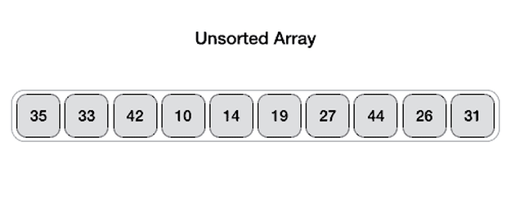
Quick Sort Animation

Slide 138
Quick sort

Slide 139
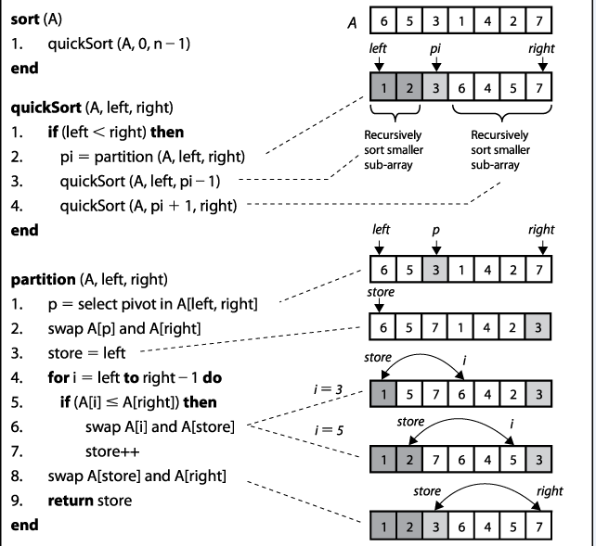

Slide 140
Quick Sort
Pass | Array | P | Left Ind.(i) | Rig. Ind | Store index | Swap
Inti. | 6 5 7 1 4 2 3 | A[6]=3

Slide 141
Quick Sort
Pass | Array | P | Left Ind.(i) | Rig. Ind | Store index | Swap
Inti. | 6 5 7 1 4 2 3 | A[6]=3
0 | 6 5 7 1 4 2 3 | A[6]=3 | A[0]=6 | A[6]=3 | A[0]=6

Slide 142
Quick Sort
Pass | Array | P | Left Ind.(i) | Rig. Ind | Store index | Swap
Inti. | 6 5 7 1 4 2 3 | A[6]=3
0 | 6 5 7 1 4 2 3 | A[6]=3 | A[0]=6 | A[6]=3 | A[0]=6
1 | 6 5 7 1 4 2 3 | A[6]=3 | A[1]=5 | A[6]=3 | A[0]=6

Slide 143
Quick Sort
Pass | Array | P | Left Ind.(i) | Rig. Ind | Store index | Swap
Inti. | 6 5 7 1 4 2 3 | A[6]=3
0 | 6 5 7 1 4 2 3 | A[6]=3 | A[0]=6 | A[6]=3 | A[0]=6
1 | 6 5 7 1 4 2 3 | A[6]=3 | A[1]=5 | A[6]=3 | A[0]=6
2 | 6 5 7 1 4 2 3 | A[6]=3 | A[2]=7 | A[6]=3 | A[0]=6

Slide 144
Quick Sort
Pass | Array | P | Left Ind.(i) | Rig. Ind | Store index | Swap
Inti. | 6 5 7 1 4 2 3 | A[6]=3
0 | 6 5 7 1 4 2 3 | A[6]=3 | A[0]=6 | A[6]=3 | A[0]=6
1 | 6 5 7 1 4 2 3 | A[6]=3 | A[1]=5 | A[6]=3 | A[0]=6
2 | 6 5 7 1 4 2 3 | A[6]=3 | A[2]=7 | A[6]=3 | A[0]=6
3 | 6 5 7 1 4 2 3 | A[6]=3 | A[3]=1 | A[6]=3 | A[0]=6 | Swap A[i] and A[store]Store ++
 | 1 5 7 6 4 2 3 | - | - | - | A[1]= 5 | -

Slide 145
Quick Sort
Pass | Array | P | Left Ind.(i) | Rig. Ind | Store index | Swap
Inti. | 6 5 7 1 4 2 3 | A[6]=3
0 | 6 5 7 1 4 2 3 | A[6]=3 | A[0]=6 | A[6]=3 | A[0]=6
1 | 6 5 7 1 4 2 3 | A[6]=3 | A[1]=5 | A[6]=3 | A[0]=6
2 | 6 5 7 1 4 2 3 | A[6]=3 | A[2]=7 | A[6]=3 | A[0]=6
3 | 6 5 7 1 4 2 3 | A[6]=3 | A[3]=1 | A[6]=3 | A[0]=6 | Swap A[i] and A[store]Store ++
 | 1 5 7 6 4 2 3 | - | - | - | A[1]= 5 | -
4 | 1 5 7 6 4 2 3 | A[6]=3 | A[4]= 4 | A[6]=3 | A[1] =5

Slide 146
Quick Sort
Pass | Array | P | Left Ind.(i) | Rig. Ind | Store index | Swap
Inti. | 6 5 7 1 4 2 3 | A[6]=3
0 | 6 5 7 1 4 2 3 | A[6]=3 | A[0]=6 | A[6]=3 | A[0]=6
1 | 6 5 7 1 4 2 3 | A[6]=3 | A[1]=5 | A[6]=3 | A[0]=6
2 | 6 5 7 1 4 2 3 | A[6]=3 | A[2]=7 | A[6]=3 | A[0]=6
3 | 6 5 7 1 4 2 3 | A[6]=3 | A[3]=1 | A[6]=3 | A[0]=6 | Swap A[i] and A[store]Store ++
 | 1 5 7 6 4 2 3 | - | - | - | A[1]= 5 | -
4 | 1 5 7 6 4 2 3 | A[6]=3 | A[4]= 4 | A[6]=3 | A[1] =5
5 | 1 5 7 6 4 2 3 | A[6]=3 | A[5]= 2 | A[6]=3 | A[1] =5 | Swap A[i] and A[store] Store++
 | 1 2 7 6 4 5 3 |  |  |  | A[2]=7

Slide 147
Quick Sort
Pass | Array | P | Left Ind.(i) | Rig. Ind | Store index | Swap
Inti. | 6 5 7 1 4 2 3 | A[6]=3
0 | 6 5 7 1 4 2 3 | A[6]=3 | A[0]=6 | A[6]=3 | A[0]=6
1 | 6 5 7 1 4 2 3 | A[6]=3 | A[1]=5 | A[6]=3 | A[0]=6
2 | 6 5 7 1 4 2 3 | A[6]=3 | A[2]=7 | A[6]=3 | A[0]=6
3 | 6 5 7 1 4 2 3 | A[6]=3 | A[3]=1 | A[6]=3 | A[0]=6 | Swap A[i] and A[store]Store ++
 | 1 5 7 6 4 2 3 | - | - | - | A[1]= 5 | -
4 | 1 5 7 6 4 2 3 | A[6]=3 | A[4]= 4 | A[6]=3 | A[1] =5
5 | 1 5 7 6 4 2 3 | A[6]=3 | A[5]= 2 | A[6]=3 | A[1] =5 | Swap A[i] and A[store] Store++
 | 1 2 7 6 4 5 3 |  |  |  | A[2]=7
6 | 1 2 3 6 4 5 7 | - | - | - | - | Swap a[store] and a[right]

Slide 148
Quick Sort
Pass | Array | P | Left Ind.(i) | Rig. Ind | Store index | Swap
Inti. | 6 5 7 1 4 2 3 | A[6]=3
0 | 6 5 7 1 4 2 3 | A[6]=3 | A[0]=6 | A[6]=3 | A[0]=6
1 | 6 5 7 1 4 2 3 | A[6]=3 | A[1]=5 | A[6]=3 | A[0]=6
2 | 6 5 7 1 4 2 3 | A[6]=3 | A[2]=7 | A[6]=3 | A[0]=6
3 | 6 5 7 1 4 2 3 | A[6]=3 | A[3]=1 | A[6]=3 | A[0]=6 | Swap A[i] and A[store]Store ++
 | 1 5 7 6 4 2 3 | - | - | - | A[1]= 5 | -
4 | 1 5 7 6 4 2 3 | A[6]=3 | A[4]= 4 | A[6]=3 | A[1] =5
5 | 1 5 7 6 4 2 3 | A[6]=3 | A[5]= 2 | A[6]=3 | A[1] =5 | Swap A[i] and A[store] Store++
 | 1 2 7 6 4 5 3 |  |  |  | A[2]=7
6 | 1 2 3 6 4 5 7 | - | - | - | - | Swap a[store] and a[right]
0 | 1 2 | A[1] =2 | A[0]= 1 | A[1]=2 | A[0]=1

Slide 149
Example

Slide 150
Quick-Sort Tree
An execution of quick-sort is depicted by a binary tree
Each node represents a recursive call of quick-sort and stores
Unsorted sequence before the execution and its pivot
Sorted sequence at the end of the execution
The root is the initial call
The leaves are calls on subsequences of size 0 or 1
7 4 9 6 2 → 4 2 6 7 9
4 2 → 2 4
7 9 → 7 9
2 → 2
9 → 9

Slide 151
Execution Example
Pivot selection
7 2 9 4 3 7 6 1 → 1 2 3 4 6 7 8
7 2 9 4 → 2 4 7
3 8 6 1 → 1 3 8
2
9 4 → 4
3 →
8 →

Slide 152
Execution Example (cont.)
Partition, recursive call, pivot selection
7 2 9 4 3 7 6 1 → 1 2 3 4 6 7 8
2 4 3 1 → 2 4 7
3 8 6 1 → 1 3 8
2 →
9 4 → 4
3 → 3
8 →
9 →
4 →

Slide 153
Execution Example (cont.)
Partition, recursive call, base case
7 2 9 4 3 7 6 1 → → 1 2 3 4 6 7
2 4 3 1 →→ 2 4
3 8 6 1 → 1 3 8
1 → 1
9 4 → 4 9
3 →
8 →
9 →
4 →

Slide 154
Execution Example (cont.)
Recursive call, …, base case, join
7 2 9 4 3 7 6 1 → 1 2 3 4 6 7 8
2 4 3 1 → 1 2 3 4
3 8 6 1 → 1 3 8
1 → 1
4 3 → 3 4
3 →
8 →
9 →
4 → 4

Slide 155
Execution Example (cont.)
Recursive call, pivot selection
7 2 9 4 3 7 6 1 → 1 2 3 4 6 7 8
2 4 3 1 → 1 2 3 4
7 9 7 1 → 1 3 8
1 → 1
4 3 → 3 4
8 →
9 →
9 →
4 → 4

Slide 156
Execution Example (cont.)
Partition, …, recursive call, base case
7 2 9 4 3 7 6 1 → 1 2 3 4 6 7 8
2 4 3 1 → 1 2 3 4
7 9 7 1 → 1 3 8
1 → 1
4 3 → 3 4
8 →
9 → 9
9 →
4 → 4

Slide 157
Execution Example (cont.)
Join, join
7 2 9 4 3 7 6 1 → 1 2 3 4 6 7 7 9
2 4 3 1 → 1 2 3 4
7 9 7 → 17 7 9
1 → 1
4 3 → 3 4
8 →
9 → 9
9 →
4 → 4

Slide 158

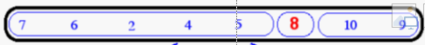
Quick-Sort Tree

Slide 159
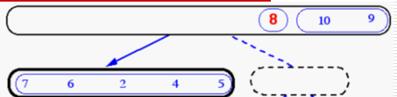
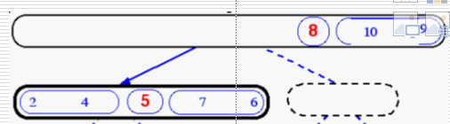
Quick-Sort Tree
Step 1
Step 2

Slide 160
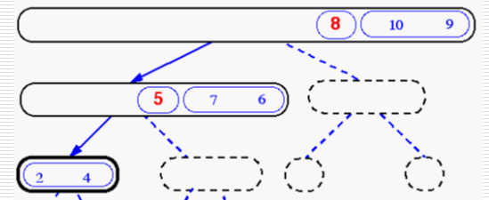
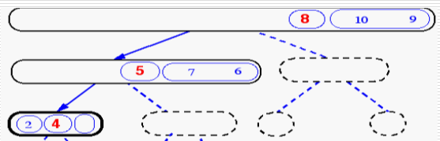
Quick-Sort Tree
Step 3
Step 4

Slide 161
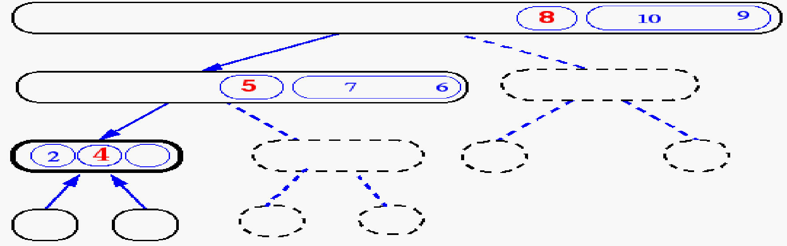
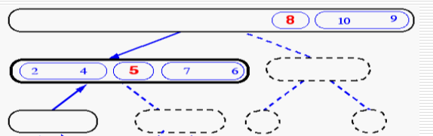
Quick-Sort Tree
Step 5
Step 6

Slide 162
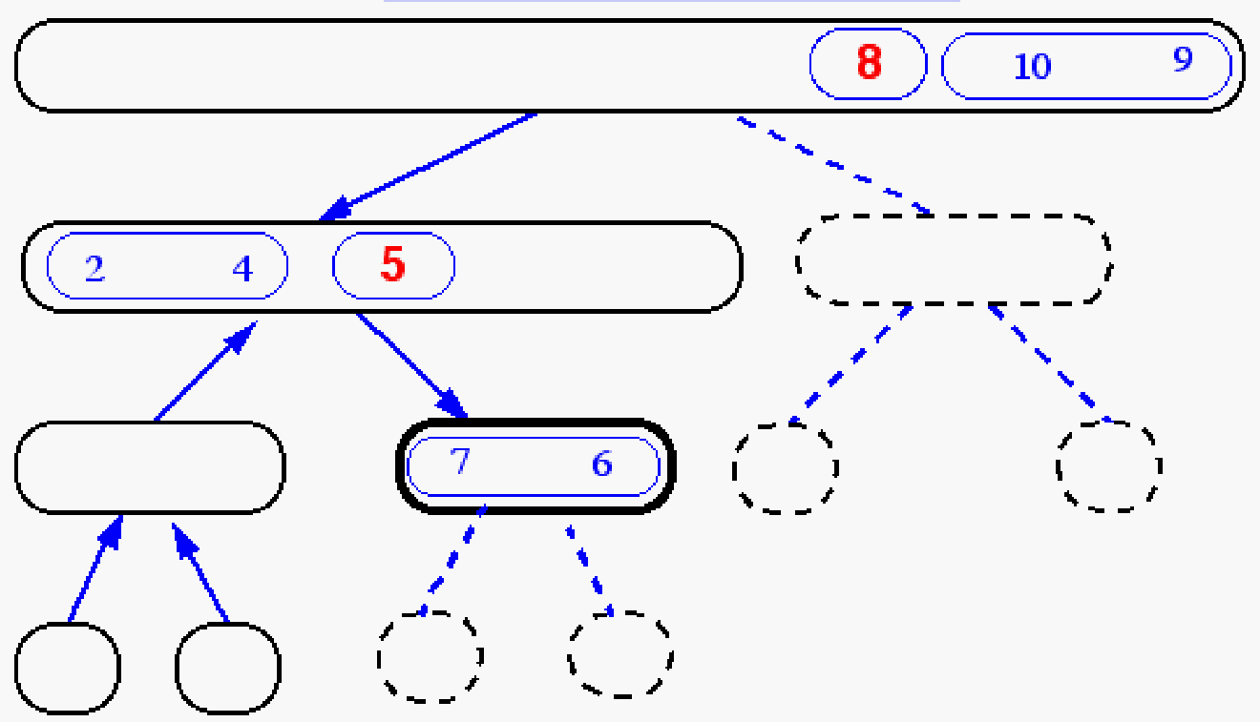
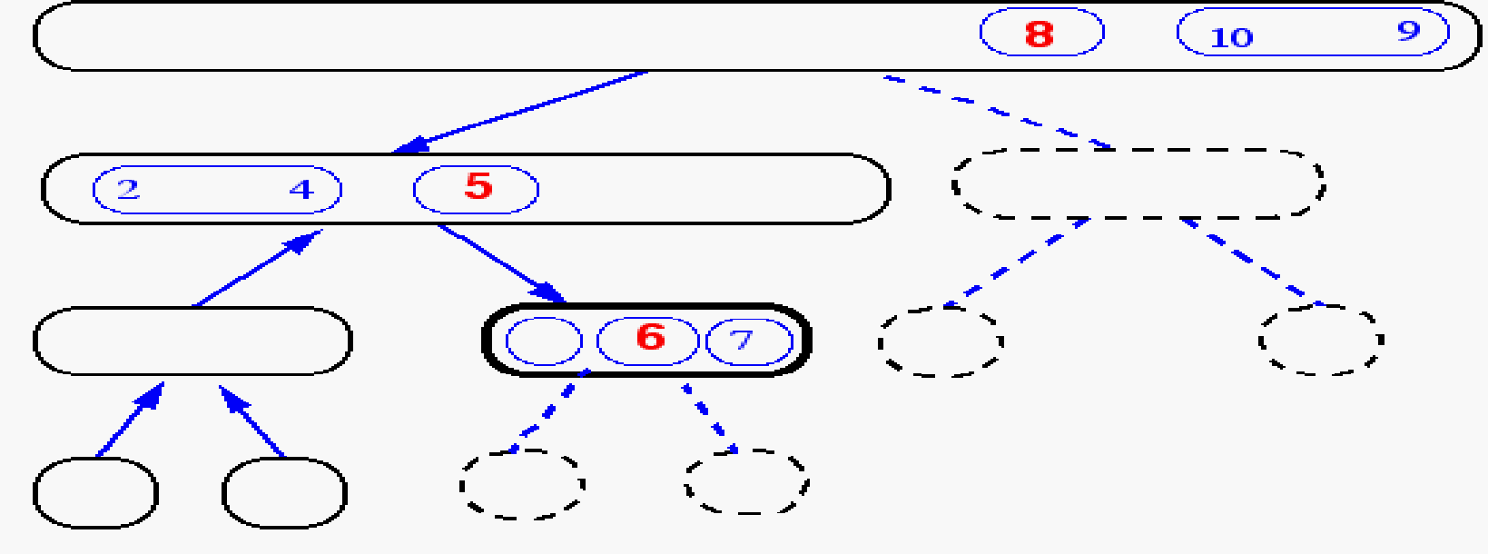
Quick-Sort Tree
Step 7
Step 8

Slide 163
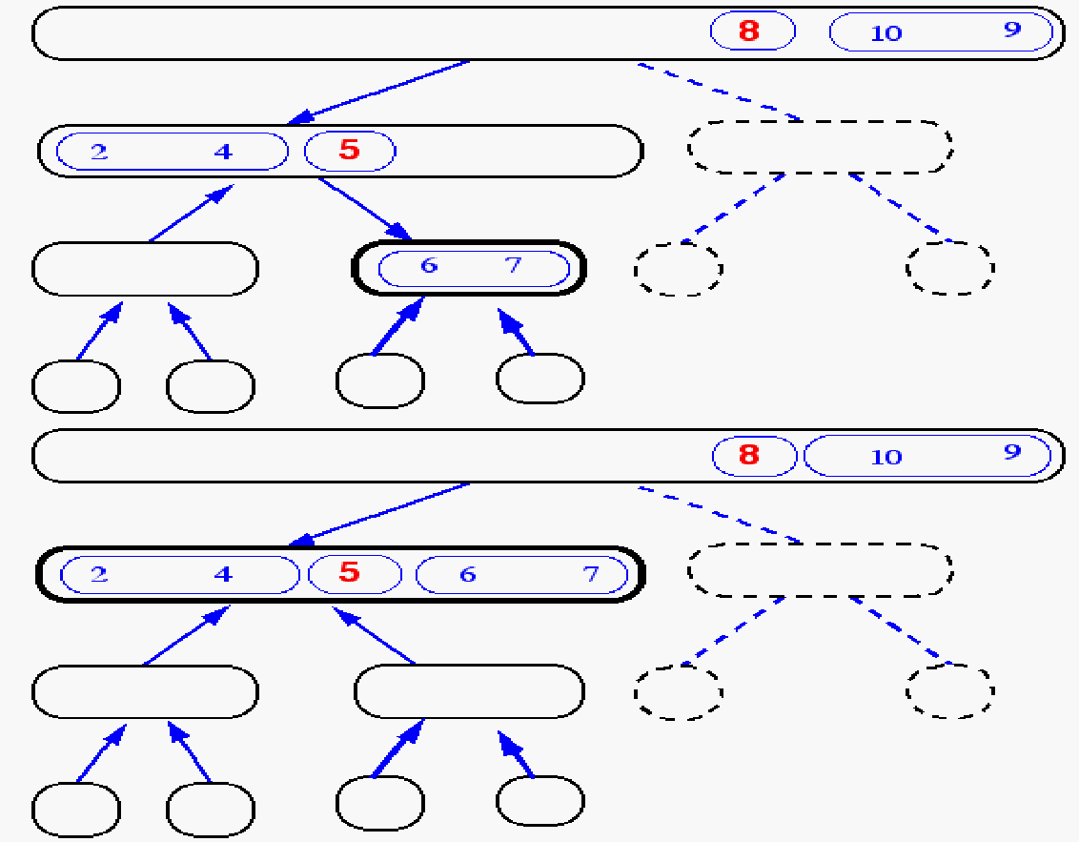
Quick-Sort Tree
Step 8
Step 9

Slide 164
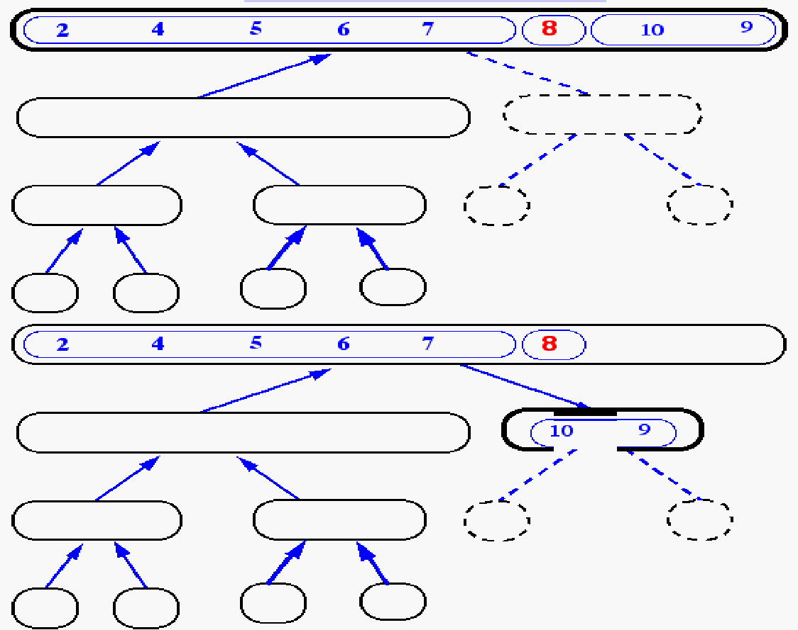
Quick-Sort Tree
Step 10
Step 11

Slide 165
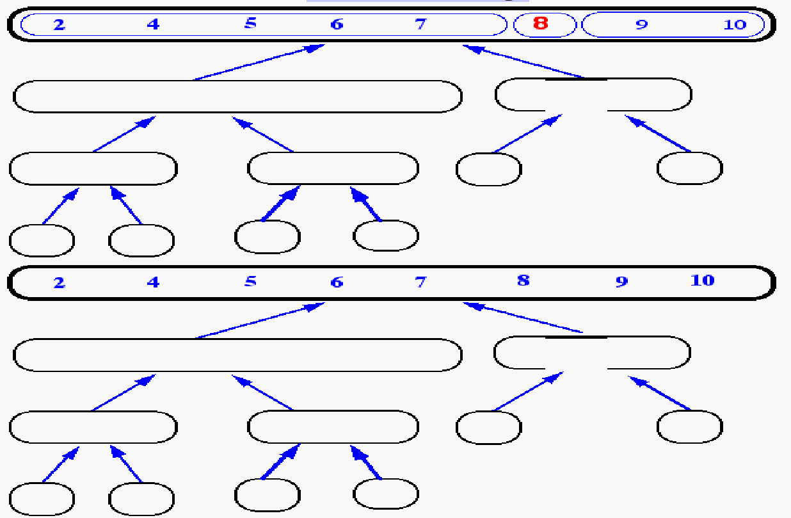
... Finally
Step 12
Step 13

Slide 166
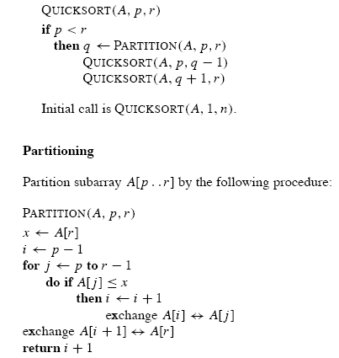
Quick Sort

Slide 167
Performance of Quick Sort
The running time of quicksort depends on the partitioning of the subarrays:
If the subarrays are balanced, then quicksort can run as fast as mergesort.
If they are unbalanced, then quicksort can run as slowly as insertion sort.

Slide 168

Best Case Analysis

Slide 169

Best Case Analysis

Slide 170

Worst Case Analysis

Slide 171

Worst Case Analysis

Slide 172


Worst Case Analysis

Slide 173

Worst Case Analysis

Slide 174

Worst Case Analysis

Slide 175

Worst Case Analysis

Slide 176

Worst Case Analysis

Slide 177
Recurrences and Running Time
An equation or inequality that describes a function in terms of its value on smaller inputs.
T(n) = T(n-1) + n
Recurrences arise when an algorithm contains recursive calls to itself
What is the actual running time of the algorithm?
Need to solve the recurrence
Find an explicit formula of the expression
Bound the recurrence by an expression that involves n

Slide 178
Example Recurrences
T(n) = T(n-1) + n Θ(n²)
Recursive algorithm that loops through the input to eliminate one item
T(n) = T(n/2) + c Θ(lgn)
Recursive algorithm that halves the input in one step
T(n) = T(n/2) + n Θ(n)
Recursive algorithm that halves the input but must examine every item in the input
T(n) = 2T(n/2) + 1 Θ(n)
Recursive algorithm that splits the input into 2 halves and does a constant amount of other work

Slide 179

Average Case Analysis

Slide 180

Average Case Analysis

Slide 181

Average Case Analysis

Slide 182

Average Case Analysis

Slide 183

Average Case Analysis

Slide 184

Average Case Analysis

Slide 185

Average Case Analysis

Slide 186
Space Complexity of Quick sort
The space complexity is calculated based on the space used in the recursion stack.
The worst case space used will be O(n) .
The average case space used will be of the order O(log n).
The worst case space complexity becomes O(n), when the algorithm encounters its worst case where for getting a sorted list, we need to make n recursive calls.

Slide 187

Lucky or Unlucky

Slide 188

Recurrence Tree

Slide 189

Recurrence Tree

Slide 190

Recurrence Tree

Slide 191

Recurrence Tree

Slide 192


Recurrence Tree
Draw the recursion tree for the recurrence relation and look for a pattern:
depth | T’s | size
0 | 1 | n
1 | 2 | n/2
i | 2^{i} | n/2^{i}
… | … | …
time
bn
bn
bn
…
Total time = bn + bn log n
(last level plus all previous levels)

Slide 193

Recurrence Tree

Slide 194
Tweaking Quicksort
Almost anything you can try to “improve” Quicksort will actually slow it down
One good tweak is to switch to a different sorting method when the subarrays get small (say, 10 or 12)
Quicksort has too much overhead for small array sizes
For large arrays, it might be a good idea to check beforehand if the array is already sorted
But there is a better tweak than this

Slide 195
Picking a better pivot
If the array is already sorted, this results in O(n²) behavior
It’s no better if we pick the last element
We could do an optimal quicksort (guaranteed O(n log n)) if we always picked a pivot value that exactly cuts the array in half
Such a value is called a median: half of the values in the array are larger, half are smaller
The easiest way to find the median is to sort the array and pick the value in the middle (!)
Obviously, it doesn’t make sense to sort the array in order to find the median to use as a pivot.

Slide 196
Median of three
Instead, compare just three elements of our (sub)array—the first, the last, and the middle
Take the median (middle value) of these three as pivot
It’s possible (but not easy) to construct cases which will make this technique O(n²)
Suppose we rearrange (sort) these three numbers so that the smallest is in the first position, the largest in the last position, and the other in the middle
This lets us simplify and speed up the partition loop

Slide 197
Final comments
Quicksort is the fastest known sorting algorithm
For optimum efficiency, the pivot must be chosen carefully
“Median of three” is a good technique for choosing the pivot
However, no matter what you do, there will be some cases where Quicksort runs in O(n²) time

Slide 198

Randomized version of quicksort

Slide 199


Randomized version of quicksort
Randomly selecting the pivot element will, on average, cause the split of the input array to be reasonably well balanced.

Slide 200
Consider an array which has many redundant elements. For example, {1, 4, 2, 4, 2, 4, 1, 2, 4, 1, 2, 2, 2, 2, 4, 1, 4, 4, 4}.

Slide 201
What is 3-Way QuickSort?
In simple QuickSort algorithm, we select an element as pivot, partition the array around pivot and recur for subarrays on left and right of pivot.
Consider an array which has many redundant elements. For example, {1, 4, 2, 4, 2, 4, 1, 2, 4, 1, 2, 2, 2, 2, 4, 1, 4, 4, 4}. If 4 is picked as pivot in Simple QuickSort, we fix only one 4 and recursively process remaining occurrences. In 3 Way QuickSort, an array arr[l..r] is divided in 3 parts:
a) arr[l..i] elements less than pivot. b) arr[i+1..j-1] elements equal to pivot. c) arr[j..r] elements greater than pivot.

Slide 202
Partition
Algorithm partition(S, p)
Input sequence S, position p of pivot
Output subsequences L, E, G of the elements of S less than, equal to, or greater than the pivot, resp.
L, E, G ← empty sequences
x ← S.remove(p)
while ¬S.isEmpty()
y ← S.remove(S.first())
if y < x
L.insertLast(y)
else if y = x
E.insertLast(y)
else { y > x }
G.insertLast(y)
return L, E, G

Slide 203
Which algorithm is preferred for sorting Arrays
Quick Sort or MergeSort
Array
Linked List

Slide 204
Why Quick Sort is preferred over MergeSort for sorting Arrays
Quick Sort in its general form is an in-place sort
Comparing average complexity we find that both type of sorts have O(NlogN) average complexity but the constants differ.
merge sort requires O(N) extra storage
Allocating and de-allocating the extra space used for merge sort increases the running time of the algorithm

Slide 205
Why Merge Sort is preferred over QuickSort for Linked Lists?
we can not do random access in linked list. Quick Sort requires a lot of this kind of access.
The overhead increases for quick sort.
Merge sort accesses data sequentially and the need of random access is low.
In linked list, we can insert items in the middle in O(1) extra space and O(1) time.
Therefore merge operation of merge sort can be implemented without extra space for linked lists.

Slide 206
Example of Divide and Conquer

Slide 207
Find the smallest missing element from the sorted array
Given a sorted array of non-negative distinct integers, find the smallest missing non-negative element in it.
For Example:
Input: nums[]={0,1,2,6,9,11,15}
Output: The smallest missing element is 3.
Input: nums[]={1,2,3,4,6,9,11,15}
Output: The smallest missing element is 0.

Slide 208
Find the smallest missing element from the sorted array
A simple analysis of the problem shows that the smallest missing number would be the element’s index, which is not equal to its element.
consider array [0, 1, 2, 6, 9, 11, 15]. Here, the smallest missing element is 3 since 6 is present at index 3 (instead of element 3). If all elements in the array are at their right position, then the smallest missing number is equal to the array size; For instance, 6 in the case of [0, 1, 2, 3, 4, 5].
One solution would be to run a linear search on the array and return the first index, which doesn’t match its value.The worst-case time complexity is O(n), where n is the size of the input.Solution does not take advantage of the fact that the input is sorted.
The problem would be solve in O(log(n)) time by modifying the binary search algorithm(compare the mid-index with the middle element. If both are the same, then the mismatch is in the right subarray; otherwise, it lies in the left subarray. ).

Slide 209

Continue

Slide 210
Find the smallest missing element from the sorted array
Given a sorted array of non-negative distinct integers, find the smallest missing non-negative element in it.
For Example:
Input: nums[]={0,1,2,6,9,11,15}
Output: The smallest missing element is 3.
Input: nums[]={1,2,3,4,6,9,11,15}
Output: The smallest missing element is 0.

Slide 211
Strassen's Matrix Multiplication

Slide 212

Basic Matrix Multiplication
Suppose we want to multiply two matrices of size N x N: for example A x B = C.
C₁₁ = a₁₁b₁₁ + a₁₂b₂₁
C₁₂ = a₁₁b₁₂ + a₁₂b₂₂
C₂₁ = a₂₁b₁₁ + a₂₂b₂₁
C₂₂ = a₂₁b₁₂ + a₂₂b₂₂

Slide 213


Basic Matrix Multiplication
algorithm
Time analysis

Slide 214
Strassens’s Matrix Multiplication
Strassen showed that 2x2 matrix multiplication can be accomplished in 7 multiplication and 18 additions or subtractions. .(2^{log}₂⁷ =2^{2.807})
This reduce can be done by Divide and Conquer Approach.

Slide 215
Divide-and-Conquer
Divide-and conquer is a general algorithm design paradigm:
Divide: divide the input data S in two or more disjoint subsets S₁, S₂, …
Recur: solve the subproblems recursively
Conquer: combine the solutions for S₁, S₂, …, into a solution for S
The base case for the recursion are subproblems of constant size
Analysis can be done using recurrence equations

Slide 216
Divide and Conquer Matrix Multiply
A × B = R
A₀ | A₁
A₂ | A₃
B₀ | B₁
B₂ | B₃
A₀×B₀+A₁×B₂ | A₀×B₁+A₁×B₃
A₂×B₀+A₃×B₂ | A₂×B₁+A₃×B₃
×
=
Divide matrices into sub-matrices: A₀ , A₁, A₂ etc
Use blocked matrix multiply equations
Recursively multiply sub-matrices

Slide 217
Divide and Conquer Matrix Multiply
A × B = R
a₀
b₀
a₀ × b₀
×
=
Terminate recursion with a simple base case

Slide 218

Divide and Conquer Matrix Multiply

Slide 219
Divide and Conquer Matrix Multiply
We do 8 multiplications for matrices of size N/2 x N/2 and 4 additions.
Addition of two matrices takes O(N²) time. So the time complexity can be written as
T(N) = 8T(N/2) + O(N²)
time complexity of above method is O(N³)

Slide 220
Strassens’s Matrix Multiplication
P₁ = (A₁₁+ A₂₂)(B₁₁+B₂₂) P₂ = (A₂₁ + A₂₂) * B₁₁ P₃ = A₁₁ * (B₁₂ - B₂₂) P₄ = A₂₂ * (B₂₁ - B₁₁) P₅ = (A₁₁ + A₁₂) * B₂₂ P₆ = (A₂₁ - A₁₁) * (B₁₁ + B₁₂) P₇ = (A₁₂ - A₂₂) * (B₂₁ + B₂₂)
C₁₁ = P₁ + P₄ - P₅ + P₇ C₁₂ = P₃ + P₅ C₂₁ = P₂ + P₄ C₂₂ = P₁ + P₃ - P₂ + P₆

Slide 221
Comparison
P₁ = (A₁₁+ A₂₂)(B₁₁+B₂₂)
P₄ = A₂₂ * (B₂₁ - B₁₁)
P₅ = (A₁₁ + A₁₂) * B₂₂
P₇ = (A₁₂ - A₂₂) * (B₂₁ + B₂₂)
C₁₁ = P₁ + P₄ - P₅ + P₇
= (A₁₁+ A₂₂)(B₁₁+B₂₂) + A₂₂ * (B₂₁ - B₁₁) - (A₁₁ + A₁₂) * B₂₂+ (A₁₂ - A₂₂) * (B₂₁ + B₂₂)
= A₁₁ B₁₁ + A₁₁ B₂₂ + A₂₂ B₁₁ + A₂₂ B₂₂ + A₂₂ B₂₁ – A₂₂ B₁₁ - A₁₁ B₂₂ -A₁₂ B₂₂ + A₁₂ B₂₁ + A₁₂ B₂₂ – A₂₂ B₂₁ – A₂₂ B₂₂
= A₁₁ B₁₁ + A₁₂ B₂₁

Slide 222
Time Analysis
Addition and Subtraction of two matrices takes O(N²)
T(N) = 7T(N/2) + O(N²)
From Master's Theorem,
time complexity of above method is
O(N^{Log7})
which is approximately
O(N^{2.8074})

Slide 223
General Divide-and-Conquer Recurrence
T(n) = aT(n/b) + f (n) where f(n) ∈ Θ(n^{d}), d ≥ 0
Master Theorem: If a < b^{d}, T(n) ∈ Θ(n^{d})
If a = b^{d}, T(n) ∈ Θ(n^{d} log n)
If a > b^{d}, T(n) ∈ Θ(n^{log b a} )
Note: The same results hold with O instead of Θ.
Examples: T(n) = 4T(n/2) + n ⇒ T(n) ∈ ?
T(n) = 4T(n/2) + n² ⇒ T(n) ∈ ?
T(n) = 4T(n/2) + n³ ⇒ T(n) ∈ ?
Θ (n^2)
Θ (n^2log n)
Θ (n^3)

Slide 224
Strassen’s Method is not preferred
Generally Strassen’s Method is not preferred for practical applications for following reasons.
The constants used in Strassen’s method are high and for a typical application Naive method works better.
2) For Sparse matrices, there are better methods especially designed for them.
3) The submatrices in recursion take extra space.
4) Because of the limited precision of computer arithmetic on noninteger values, larger errors accumulate in Strassen’s algorithm than in Naive Method

Slide 225
Multiplication of Large Integer H.W

Slide 226
Naive Multiplication
The standard integer multiplication routine of two n-digit numbers involves n multiplications of an n-digit number by a single digit, plus the addition of n numbers, which have at most 2n digits.
All in all, assuming that each addition and multiplication between single digits takes O(1), this multiplication takes O(n²) time:

Slide 227
Final comments
quantity time
1) multiplication n-digit
by 1-digit n O(n)
2) additions 2n-digit by
n-digit max n O(n)
Total time = n*O(n) + n*O(n)
= 2n*O(n)
= O(n)*O(n)
= O(n²).

Slide 228



Divide & Conquer

Slide 229

Recurrence Relation

Slide 230

General Templete

Slide 231
When not to Use D&C
Case 1: An instance of size n is divided into two or more instances almost of size n.
F(n) = f(n-1) + f(n-1)
Complexity = 2^{N}
Case 2 : An instance of size N is divided into almost n instances of size n/c where c is a constant.
Complexity : n^{(lg n)}

Slide 232

When not to Use D&C

Slide 233
Segregate positive and negative integers using merge sort
Given an array of positive and negative integers, segregate them without changing the relative order of elements. The output should contain all positive numbers follow negative numbers while maintaining the same relative ordering.
For example,
Input: [9, -3, 5, -2, -8, -6, 1, 3]
Output: [-3, -2, -8, -6, 9, 5, 1, 3]

Slide 234
Maximum Subarray Sum using Divide and Conquer
Given an integer array, find the maximum sum among all subarrays possible.
The problem differs from the problem of finding the maximum subsequence sum. Unlike subsequences, subarrays are required to occupy consecutive positions within the original array.
For example,
Input: nums[] = [2, -4, 1, 9, -6, 7, -3]
Output: The maximum sum of the subarray is 11 (Marked in Green)

Slide 235
The idea is to use Divide and Conquer technique to find the maximum subarray sum. The algorithm works as follows:
Divide the array into two equal subarrays.
Recursively calculate the maximum subarray sum for the left subarray,
Recursively calculate the maximum subarray sum for the right subarray,
Find the maximum subarray sum that crosses the middle element.
Return the maximum of the above three sums.

Slide 236
Find `k` closest elements to a given value in an array
Given a sorted integer array, find the k closest elements to target in the array where k and target are given positive integers.
The target may or may not be present in the input array. If target is less than or equal to the first element in the input array, return first k elements. Similarly, if target is more than or equal to the last element in the input array, return the last k elements. The returned elements should be in the same order as present in the input array.

Slide 237
For example,
Input: [10, 12, 15, 17, 18, 20, 25], k = 4, target = 16
Output: [12, 15, 17, 18]
Input: [2, 3, 4, 5, 6, 7], k = 3, target = 1
Output: [2, 3, 4]
Input: [2, 3, 4, 5, 6, 7], k = 2, target = 8
Output: [6, 7]

Slide 238
Find the minimum and maximum element in an array using Divide and Conquer
Given an integer array, find the minimum and maximum element present in it by making minimum comparisons by using the divide-and-conquer technique.
Input: nums = [5, 7, 2, 4, 9, 6]
Output:
The minimum array element is 2
The maximum array element is 9

Slide 239
Interpolation search
Given a sorted integer array and a target, determine if the target exists in the array or not using an interpolation search algorithm. If the target exists in the array, return the index of it.

Slide 240
Efficiency comparison of two algorithms
 | Insertion Sort | Merge Sort
Machine Architecture | one billion(10⁹)/second(A) | ten million (10⁷⁾/second (B)
Programming Skill
Complexity
Input Size
Input Quality
Time Required

Slide 241
Efficiency comparison of two algorithms
 | Insertion Sort | Merge Sort
Machine Architecture | one billion(10⁹)/second(A) | ten million (10⁷⁾/second (B)
Programming Skill | Best programmer (c₁=2), | Bad programmer (c₂=50),
Complexity
Input Size
Input Quality
Time Required

Slide 242
Efficiency comparison of two algorithms
 | Insertion Sort | Merge Sort
Machine Architecture | one billion(10⁹)/second(A) | ten million (10⁷⁾/second (B)
Programming Skill | Best programmer (c₁=2), | Bad programmer (c₂=50),
Complexity | c₁n² | c₂n (lg n)
Input Size
Input Quality
Time Required

Slide 243
Efficiency comparison of two algorithms
 | Insertion Sort | Merge Sort
Machine Architecture | one billion(10⁹)/second(A) | ten million (10⁷⁾/second (B)
Programming Skill | Best programmer (c₁=2), | Bad programmer (c₂=50),
Complexity | c₁n² | c₂n (lg n)
Input Size | n=10⁶ numbers | n=10⁶ numbers
Input Quality
Time Required

Slide 244
Efficiency comparison of two algorithms
 | Insertion Sort | Merge Sort
Machine Architecture | one billion(10⁹)/second(A) | ten million (10⁷⁾/second (B)
Programming Skill | Best programmer (c₁=2), | Bad programmer (c₂=50),
Complexity | c₁n² | c₂n (lg n)
Input Size | n=10⁶ numbers | n=10⁶ numbers
Input Quality | Worst | Worst
Time Required

Slide 245
Efficiency comparison of two algorithms
 | Insertion Sort | Merge Sort
Machine Architecture | one billion(10⁹)/second(A) | ten million (10⁷⁾/second (B)
Programming Skill | Best programmer (c₁=2), | Bad programmer (c₂=50),
Complexity | c₁n² | c₂n (lg n)
Input Size | n=10⁶ numbers | n=10⁶ numbers
Input Quality | Worst | Worst
Time Required

Slide 246
Efficiency comparison of two algorithms
 | Insertion Sort | Merge Sort
Machine Architecture | one billion(10⁹)/second(A) | ten million (10⁷⁾/second (B)
Programming Skill | Best programmer (c₁=2), | Bad programmer (c₂=50),
Complexity | c₁n² | c₂n (lg n)
Input Size | n=10⁶ numbers | n=10⁶ numbers
Input Quality | Worst | Worst
Time Required

Slide 247
Efficiency comparison of two algorithms
 | Insertion Sort | Merge Sort
Machine Architecture | one billion(10⁹)/second(A) | ten million (10⁷⁾/second (B)
Programming Skill | Best programmer (c₁=2), | Bad programmer (c₂=50),
Complexity | c₁n² | c₂n (lg n)
Input Size | n=10⁶ numbers | n=10⁶ numbers
Input Quality | Worst | Worst
Time Required

Slide 248
Efficiency comparison of two algorithms
 | Insertion Sort | Merge Sort
Machine Architecture | one billion/second(A) | ten million/second (B)
Programming Skill | Best programmer (c₁=2), | Bad programmer (c₂=50),
Complexity | c₁n² | c₂n (lg n)
Input Size | n=10⁶ numbers | n=10⁶ numbers
Input Quality | Worst | Worst
Time Required | 2 (10⁶)² instructions/10⁹ instructions per second = 2000 seconds. | 50 (10⁶ lg 10⁶) instructions/10⁷ instructions per second ≈ 100 seconds.
Thus, merge sort on B is 20 times faster than insertion sort on A!
If sorting ten million numbers, 2.3 days VS. 20 minutes.

Slide 249


Slide 250
Quicksort Algorithm
Given an array of n elements (e.g., integers):
If array only contains one element, return
Else
pick one element to use as pivot.
Partition elements into two sub-arrays:
Elements less than or equal to pivot
Elements greater than pivot
Quicksort two sub-arrays
Return results

Slide 251
Example(Skip)
We are given array of n integers to sort:
40
20
10
80
60
50
7
30
100

